Slide 1
Austrian experience in waste management
© iStockphoto.com/sodafish

Slide 2
Waste Management Costs in Austria

Slide 3
Costs of waste collection and transport
Waste from households, schools, commerce < 240 l/week
Waste from industries
Fees for municipal waste management per household: + 100 €/a (2009)
HH= Households, Source: denkstatt 2009

Slide 4
Treatment costs
Thermal treatment or mechanical-biological treatment of mixed household waste
135 – 155/200 €/t
Composting, biogas from separately collected bio-waste:
40 – 60 €/t
Price situation for the incineration of waste oils and solvents in the Austrian cement industry: 50 - 100 € per ton (average, with a range of about up to € 160 paid for high quality waste oil and up to € 100 received for incineration of solvents) => MARKET PRICE1
=> Source separation is often cost efficient!
Source: denkstatt 2009

Slide 5
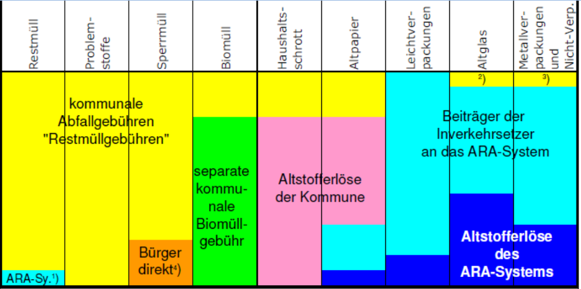
Financing of MSW management
HH= Households, Source: denkstatt 2009

Slide 6
Organising the
Waste Management System

Slide 7
Waste Collection System Households (+commerce with ≤ 240 l/week)
 | Separate bins at house | Collection points | Civic amenity sites | Take back in shops
Residual waste | X
Paper | X | (X) | X
Biodegradable | X |  | X
Plastic packaging | X | (X) | X
Metal packaging |  | X | X
Glass |  | X | X
Textiles |  | (X) | X
Batteries |  |  | X | X
WEEE |  |  | X | X

Slide 8
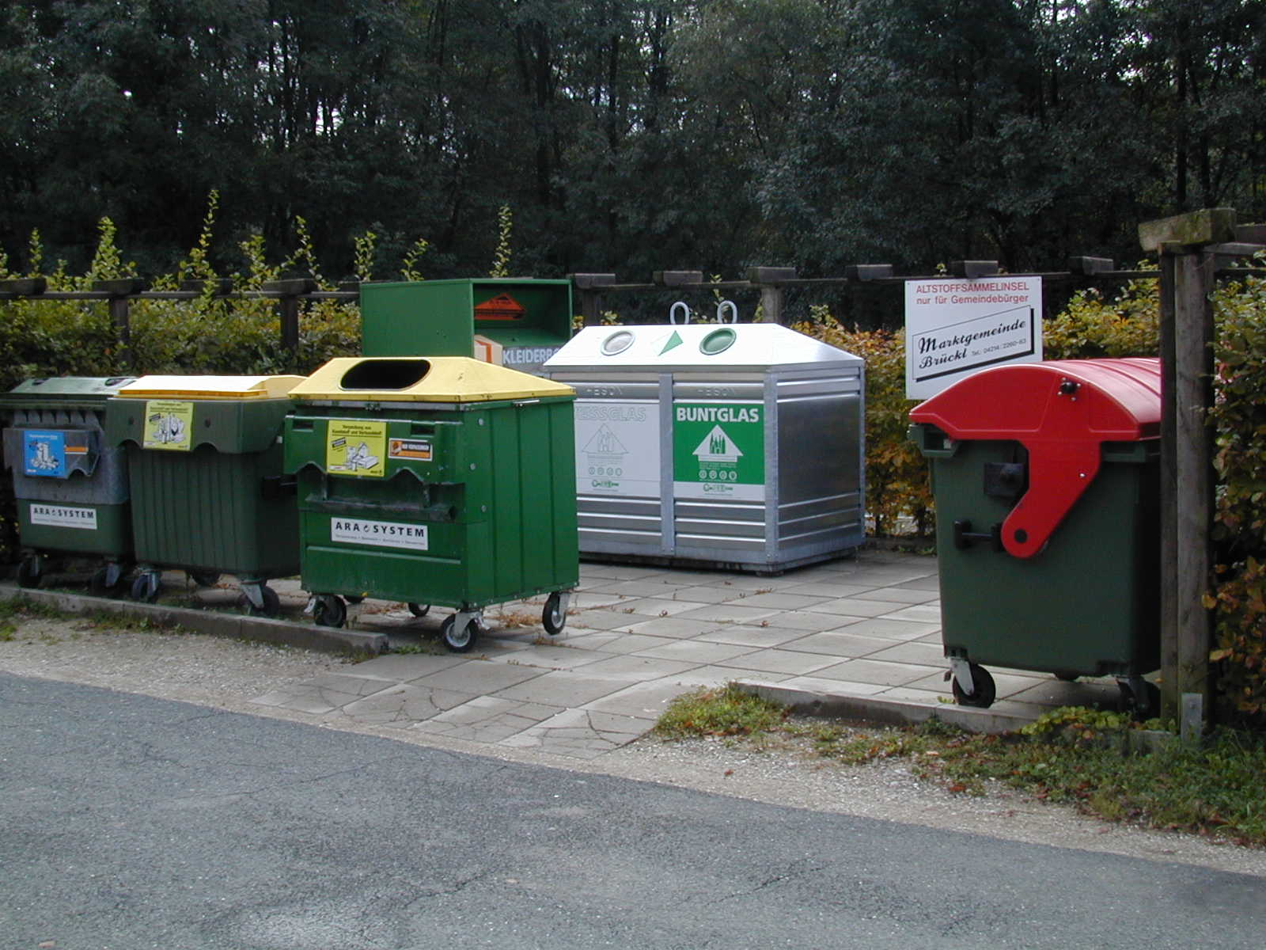
Collection Points

Slide 9
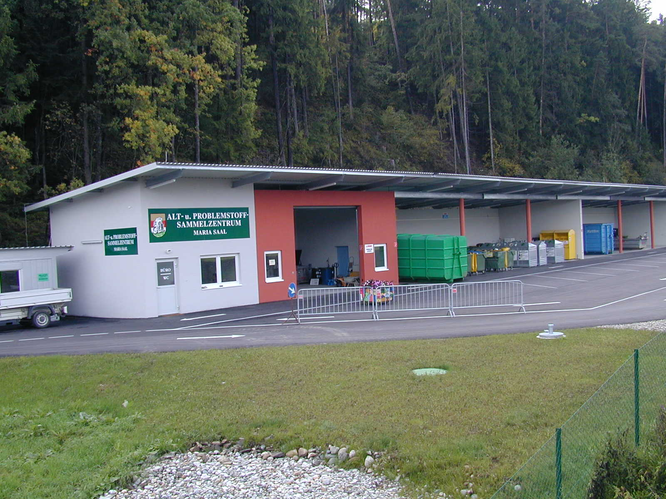
Civic amenity sites

Slide 10
Location of MBT and waste incineration plants
MBT
MBT
MBT
MBT
MBT
MBT
MBT
MBT
MBT
MBT
MBT
MBT
MBT
MBT
MBT
MBT
MBT
MBT
MBT
MBT
MBT
MBT
MBT
5
0
10
20
30
40
50
km
Waste incineration plant operating
Waste incineration plant planned/under construction
MBT
Mechnical-Biological-Treatment-(MBT)-Plant operating
MBT
MBT-Plant planned/under construction

Slide 11
Separate collection of household waste 2007
Household waste arisings:
167 kg/cap (37.4 %) residual waste
281 kg/cap (62.6 %) separately collected.
Recycables
Recycables(160 kg/cap):
80 % recycled
17 % used for energy recovery.
Source: Federal Waste Management Plan Statusbericht 2008

Slide 12
Effects of integrated waste management on the generation of secondary waste

Slide 13
Secondary wastes/required capacities for waste treatment
MSW-incineration: Slags and ashes ~1/3 of original volume, 10% of original weight
MBT: 30 – 40 % of input => landfill 30% => (co-) incineration
Recycling: in most cases at least 1 pre-treatment step is required
=> Less landfill capacity needed in an differentiated waste management, at the expense of additional other treatment capacities
Source: denkstatt 2009

Slide 14
Recovery and Disposal Plants
Plant Type | Total Capacity in Mt/a 2005 | Number of Plants 2005 | Change till 2008
Sorting Plants | 1 | 123 | + 10
Municipal Solid Waste incineration | 1.7 | 9 | +1
Other Incineration | 2.9 | 180 | +7
Mechanical-Biological Treatment (MBT) | 0.8 | 16 | +1
Composting + Biogas | 1.4 | 780 | Composting + 13
Physical-Chemical Treatment | 0.5 | 37 | +0
Treatment of Construction Waste | 5.5 | 293 | +48
Landfills |  | 666 | -118
Special Treatment + Recycling | 2.4 | 190
Source: Federal Waste Management Plan 2006, Statusreport 2008

Slide 15
Location of MBT and waste incineration plants
MBT
MBT
MBT
MBT
MBT
MBT
MBT
MBT
MBT
MBT
MBT
MBT
MBT
MBT
MBT
MBT
MBT
MBT
MBT
MBT
MBT
MBT
MBT
5
0
10
20
30
40
50
km
Waste incineration plant operating
Waste incineration plant planned/under construction
MBT
Mechnical-Biological-Treatment-(MBT)-Plant operating
MBT
MBT-Plant planned/under construction

Slide 16
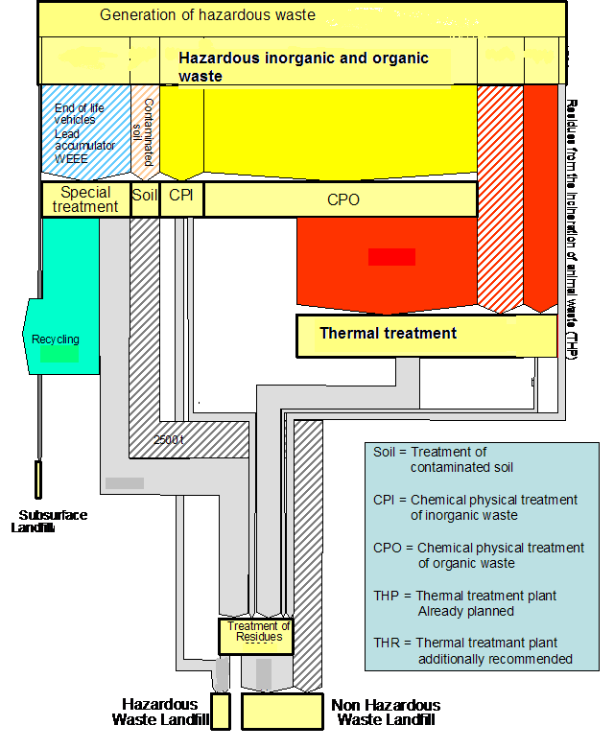
Overall picture of hazardous waste management – combination of different treatment methods (schematic picture)

Slide 17
Costs and Benefits of Remediation of contaminated sites, and effects on the waste management sector

Slide 18
Remediation of contaminated sites as source for secondary waste
 |  | Remediation of Contaminated sStes
 | Landfilled Waste (Total) | Excavated contaminated material | of which landfilled | % of total landfilled waste
 | [Mio. t/a] | [Mio. t/a] | [Mio. t/a]
1998 | 7 | 1 | 0,8 | 11%
1999 | 6 | 0,9 | 0,2 | 3%
2000 | 7,9 | 0,5 | 0,3 | 3%
2001 | 7,5 | 0,1 | 0
2002 | 8,6 | 1,7 | 1,2 | 14%
2003 | 10,5 | 4,5 | 3,1 | 29%
2004 | 9,7 | 0,7 | 0,7 | 8%
Sum (7 years) | 57,2 | 9,4 | 6,2 | 10%
Source: Remediation of contaminated waste in Austria (Umweltbundesamt and KPC, 2007)

Slide 19
Effects of remediation of contaminated sites on the Austrian waste management sector
In the last years,
1% of total waste generation (+/- 50 Mio. t/y) and
6% of total excavated material, mostly soil (+/- 20 Mio. t/y)
stem from remediation of contaminated sites.
10% of total landfilled waste is secondary waste from remediation.

Slide 20
Costs of remediation of contaminated sites - financing
The fund for remediation of contaminated sites was established in 1989. Since then ~ 150 sited were remediated.
The fund spends in average 50 Mio €/y for project funding, of which 35% go to the waste management sector and 45 % to the construction sector.
For ~50 % of remediation projects, the remediation method was excavation and disposal of the material as waste.

Slide 21
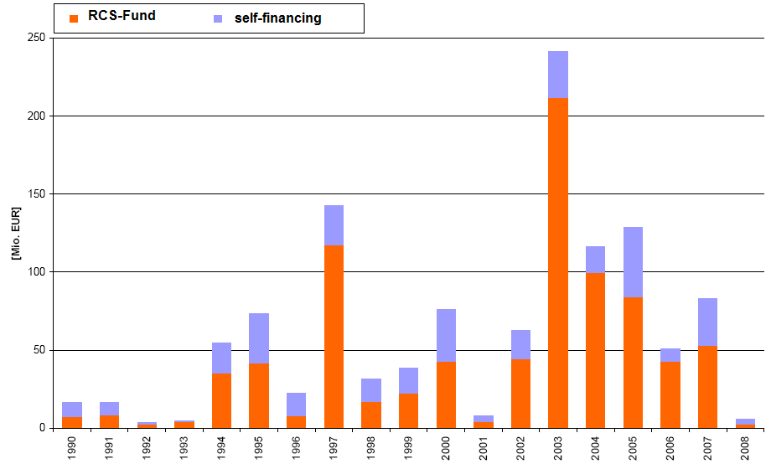
Costs and financing of remediation
Source: Remediation of contaminated waste in Austria (Umweltbundesamt and KPC, 2007)

Slide 22
Contact & Information
Brigitte Karigl
+43 1 31304 5568
brigitte.karigl@umweltbundesamt.at
Umweltbundesamt www.umweltbundesamt.at
Green Serbia Belgrade■ 29.2.2012

