Slide 1
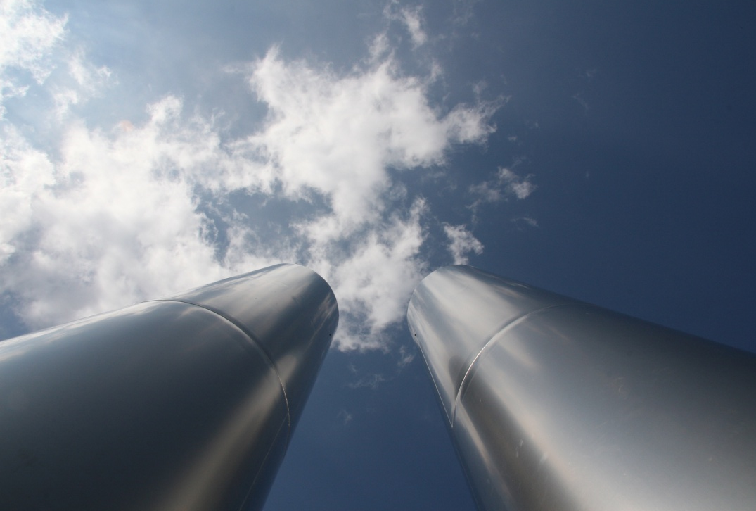
Georg Rebernig, Environment Agency Austria
4th Conference GREEN ECONOMY, Belgrade, 1 March 2013
© Thomas Seegers – Fotolia.com

Slide 2
Environment Agency Austria
Established 1985
Expert Institution on Environment of Austrian Government
Monitoring & Reporting; Policy Consulting
Turnover approx. 40 m€ (2012)
480 Employees
Strong international network (national environment agencies, EU-institutions, universities, public sector, media)
International Activities such as „Twinning Projects“ (about 100 since 1999): support in capacity building, transposition and implementation of EU legislation, policy advice
Cooperation with Serbia since 2008, 5 TW-Projects, 1 TA

Slide 3

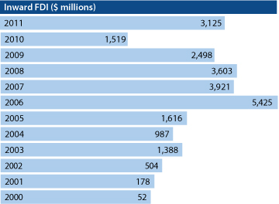














Foreign direct investments –
12.9% from Austria in 2011
3
Source: National Bank of Serbia
Notes:
WKO: Austria No. 1 in Foreign Direct Investments (FDI)

Slide 4
Serbia‘s Association Process
  EU candidate status 1st March 2012
  Accession talks might start before summer 2013
  Tentative accession date (assumed by National Environmental Approximation Strategy - NEAS): 1.1.2019
4
Source: European Commission, Serbia 2012 Progress Report
Notes:
Dokument:
sr_rapport_2012_en
Info:
p 57; 4.27 Environment and climate change
Ergänzende Info:
p 37; 4.11 Agriculture and rural development
p 39; 4.12 Food safety, veterinary and pytosanitary
p 42; 4.15 Energy

Slide 5
EU Environmental Legislation I
Environmental Policy is one of the most important areas of Union policy
EU environmental policy covers all relevant areas (with the exception of soil)
The EU environmental acquis consists of more than 300 legal instruments
Some EU environmental provisions incur very high costs: Landfill Directive, UWWTD, EID

Slide 6
EU Environmental Legislation II
Horizontal - EIA, SEA, Envi Information, Participation,…
Air: Air Quality FD, NEC, Quality of Fuels, vehicle emissions,…
Climate Change Mitigation: emission trading, 20-20-20 targets,…
Waste: WFD, Hazardous WD, Packaging, Landfill, Shipment, Mining Waste, Electronic Waste
Water: WFWD, UWWTD, Nitrates, Groundwater, Floods,…
Nature Protection: HabitatsD, BirdsD,…
Industrial Pollution: IED (IPPC, Waste Incineration, LCP), Seveso,…
Chemicals, GMOs: REACH,…

Slide 7
Serbia‘s Association Progress
EC Progress Report October 2012
  Environmental Strategy: National Environmental Approximation Strategy adopted (Oct.2011)
  Transposition of Legislation: some good progress: i.a. EIA-D fully transposed; Hazardous Waste almost fully transposed; international conventions ratified
  Monitoring: some progress: i.e. Air Quality Monitoring
  Administrative Capacity: still weak in central areas i.e. Seveso
  Implementation: further efforts needed (water, air, waste, industrial pollution) some progress: collection rate of households waste increased to 72%, waste infrastructure further expanded (Treatment plants, landfills), improvements in water quality, construction of WWTP ongoing, construction of landfills ongoing

Slide 8
Challenges for Serbia regarding
European Ecology Integration
Air quality shall be improved (PM, SO₂, NO_{x})
Water pollution: improvements in drinking water security necessary; (in particular) major towns, requirement for industrial waste water treatment
Waste: About 72% of municipal solid waste is collected. Hazardous waste shall be collected separately, treatment plants need to be established; closure of dumps
Contaminated sites: clean-up necessary to protect groundwater, air
8

Slide 9
Total Cost of Approximation I
Total cost of meeting requirements of environmental acquis estimated €10.6 bn (between 2012 and 2030); i.p. ”heavy investment directives”:
water: €5.6 bn (UWW, DW, Nitrates)
waste: €2.8 bn (Landfill, Packaging, WEEE)
industrial pollution: €1.3 bn (IED/LCP, Waste Inc.)
Air Q & Climate Change: €0.5 bn
→ peak of add. annual public spending in 2018: m€ 360
9
Source: National Environmental Approximation Strategy for the Republic of Serbia (Dec. 2011)
Notes:
Dokument:
EAS-Strategija-ENG-FINAL
Info:
p 25; 2.4.2.2 Cost of Approximation

Slide 10
Total Cost of Approximation II
Source: National Environmental Approximation Strategy for the Republic of Serbia (Dec. 2011)

Slide 11
Benefits of Approximation I
Damage avoided to life (reduced mortality);
Damage avoided to health (reduced morbidity);
Damage avoided to property and agricultural production;
Benefits to the ecosystem.
Source: National Environmental Approximation Strategy for the Republic of Serbia (Dec. 2011)

Slide 12
Benefits of Approximation II
Cost-Benefit Results of Applying the Acquis; medium-range benefit estimation; in m€
 | Benefits | Costs
Water | 7,9 | 5,6
Waste | 2,7 | 2,8
Air & Ind Pollution | 14,7 | 2,0
Others | n.m. | 0,2
Total | 25,3 | 10,6
Source: National Environmental Approximation Strategy for the Republic of Serbia (Dec. 2011)

Slide 13
Approximation & Integrated Air Quality / Climate / Energy Policies
Immissions: „CAFE-Directive“ setting air quality limit values
Emissions: National Emission Ceilings (NEC)-Directive
Reduction of emissions from point sources: Industrial Emissions Directive (IED)
Greenhouse Gas (GHG)-Reduction: Emission Trading System for Industry and Power Generation, Energy Efficiency Directive, Renewables (RES) Directive

Slide 14
Power Generation & Industry
  Power Generation:
  Demand for electricity will grow
  hydro, wind, other renewables – feed in tariffs
  retrofitting,
  combined power and heat
  reduce conventional pollutants (i.p. SOx, NOx, PM)
  Strenghten grid; regional & European integration
  Demand side management: smart metering
  Industry:
  Increased efficiency, recycling, close „ressource-loops“
  Technology and innovation
  Co-Incineration of certain wastes, thermal recovery

Slide 15
Housing & Transport
  Buildings:
  highest potential for efficiency
  thermal insulation
  improve heating control systems
  renew heating systems
  metering, tariffs
  use of RES (solarthermal, biomass,…)
  existing technologies
  Transport:
  promote public transport (passangers and freight)
  catalytic converters
  promote efficient vehicles

Slide 16
Case for Integrated Policy
  High potential for energy efficiency (Serbian economy by factor 2,7 less efficient than OECD-average)
Comply with EU legislation
Good chance because of single Ministry for Energy/(Development)/Climate/Environment
Synergies between reduction of „conventional“ air pollutants, GHG-reduction and energy policy objectives (i.a. reduced imports of oil, cope with high gas prices)
Potential to stimulate economy and fight unemployment: „green jobs“: construction, waste management/ressource efficiency

Slide 17
Thank you for your attention
Contact & Information:
Georg Rebernig
+43 1 31304 5524
georg.rebernig@umweltbundesamt.at
Umweltbundesamt
www.umweltbundesamt.at
Green Economy
Belgrade, Serbia ■ 1 March 2013
17

