Slide 1

IMPACT- Municipal Waste and Wastewater Management in Serbia
Conference "GREEN ECONOMY“, 01.03.2013

Slide 2
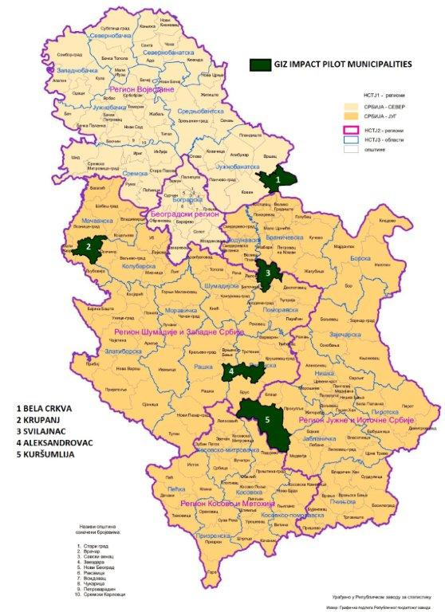
Pilot Municipalities of GIZ IMPACT Project
Population up to 30,000 inhabitants;
Development level belonging to the second, third and fourth group
No private operator
providing utility
services;
Bela Cyrkva
Svilajnac
Krupanj
Kuršumlija
Aleksandrovac

Slide 3
Main project partners
Ministry of Energy, Development and Environmental Protection,
Ministry of Agriculture, Forestry and Water Management
Serbian Agency for Environmental Protection
Standing Conference of Towns and Municipalities
Zero Emission Network Serbia
Universities (Belgrade, Novi Sad)
5 Pilot Municipalities

Slide 4
Implementation Agenda
Material Flow Analysis (MFA)
Introduction of Material Flow Management (MFM)
Extension to regional partners/surrounding municipalities
Master planning ((Pre-)feasibility Studies) with bankable business plans for related facilities
Implementation (construction, training, operation and maintenance, monitoring and evaluation, improvement)
Transfer of gained experience to other Serbian municipalities

Slide 5
Municipalities as partner
MFA (material flow analysis) is a methodological concept used in designing and providing information on anthropogenic systems (anthropogenic metabolism). It is a systematic assessment of flows and stocks of materials within a system defined in space and time.
Approaches of operational material flow management (MFA) in companies may be used equally within local governments.
A municipality will be regarded as a holistic system of different material flows. Combined management of existing material flowsnot utilized beforehand (e.g. green waste, cuttings) lead to creating additional values or more cost efficient disposal. This approach produces added value for municipalities by reducing costs and fostering existing local structures (craftmanship, agriculture, business etc.) .

Slide 6
Material Flow Management
Sustainable material flow management starts by using systemic and integrative approches.
Due to the cross-sectoral characteristics of the task and the interdisciplinary composition of acting stakeholders, intermunicipal cooperation and networking is on the agenda. This is where a combination of activities of local companies, municipalities and governmental bodies takes place.
Implementation of an efficient material flow management is not only an environmental must but also a part of an regional economic promotion process.

Slide 7
Circular (Green) Economy
Circular economy takes the material flow of nature as a model, aiming at using raw materials and energy as far as possible in an optimised way, for a longer time as well as in an ecological and social manner.
Material flow management (MFA) is an unique instrument to realise the objectives of circular economy.
The vision behind is aiming at giving reality to a society who uses circular economy by consequent material flow management within its enterprises and regions.

Slide 8
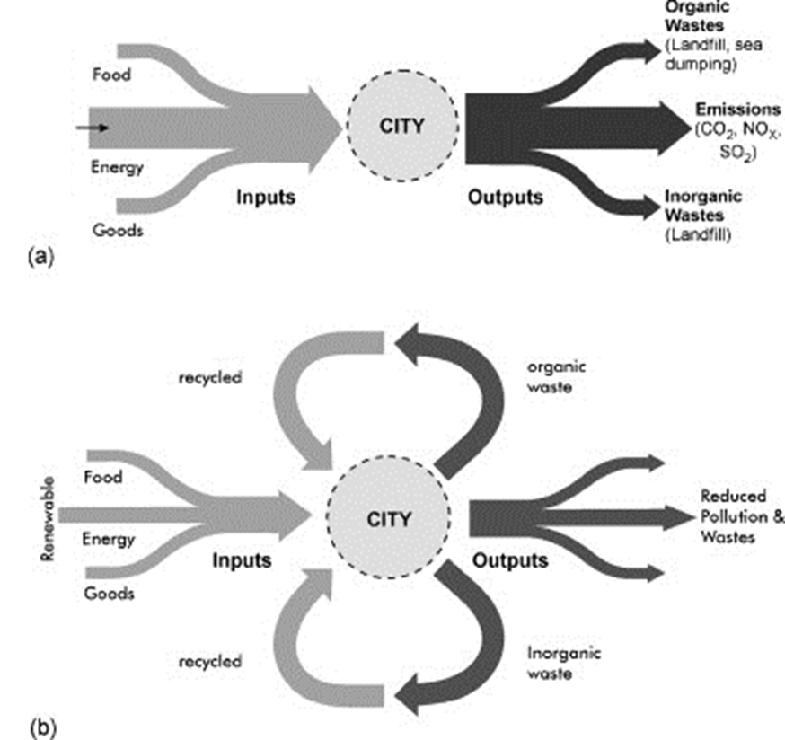
Linear economy
Circular economy
Source: Eaton et al., 2007

Slide 9
Source: IfaS

Slide 10
Sustainable material flow management allows:
  Reduction of raw material consumption
  Opening of own raw material potentials
  Multi-usage of raw materials
  Usage of waste as secondary raw materials
  Employment of renewable energies
  Improvement of energy efficiency
  Decentralisation of energy supply
The development of the former classical waste management towards a resource management is a logical output of implementing the circular economy idea in a consistent way.

Slide 11
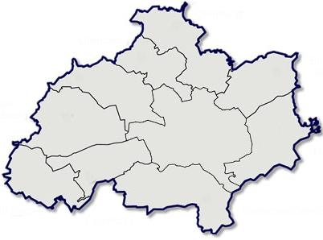









Circular Economy with MFM approach
Material / Energy Flows
Financial Resources
Potentials
Activated Regional
Resources
Regional added value

Slide 12
Thank you for your attention!
Klaus Schmidt
GIZ IMPACT
Ilije Garašanina 4/10, Beograd
Telefon: +381 11 33 44 342
E-mail: Klaus.Schmidt1@giz.de, impact@giz.de
I: www.giz.de

