Slide 1
RES and EE in the Republic of Macedonia and the region
Lazar Gechevski Director, Energy Agency of the Republic of Macedonia
Belgrade, December 5, 2011

Slide 2
General information for the Republic of Macedonia
25.713 km² -area.
Population : 2,1 million.
The supply of energy is based on domestic fossil fuels and hydro power.
The rest is provided from imported gas, liquid fuel and coal.
Total energy demand is about 120.000 TJ.
57 GJ per capita.
Electricity consumption is about 9.000 GWh.
Import of electricity 3.000 GWh (500 М€/annually).

Slide 3
Final energy consumption planned for 2011
Geothermal
energy
Wood for heating
Natural gas
Electricity
Oil fuels
Coal
Cox
Other solid fuels

Slide 4
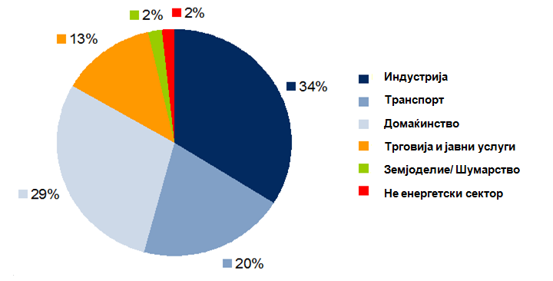
Final energy consumption by sector in %
.
Industry 34%
Transport 20%
Households 29%
Trade and public services 13%
Agriculture /Forestry 2%
Other sectors 2%

Slide 5
Production of electricity
72%

Slide 6
Legislation in Republic of Macedonia
New Energy Law (in force from 18.02.2011)
Strategy for energy development
Strategy for energy efficiency
Strategy for the use of Renewable Energy Sources
Action plan for Energy Efficiency
National feed-in Tariffs
Act for limitation of installed capacity
Rulebook for Renewable energy sources
Rulebook for obtaining status of preferential producer of electricity produced from highly efficient plants with combined production
Rulebook for issuing Guarantees of origin for production of electricity produced from RES and highly efficient plants with combined production

Slide 7
Responsibilities of the Energy Agency of the Republic of Macedonia
Participation in the preparation of strategies and action plans for energy ( EE and RES)
Development of the national energy balance
Trainings and exams for future energy auditors
Review of 3-year Strategy plans and one-year reports on EE and RES of all 84 municipalities
Issuing approvals to measure wind energy
Issuing certificate for obtaining the status of preferential producer of electricity from RES and highly efficient cogeneration plants
Issuing guarantees of origin for electricity produced from RES and highly efficient cogeneration plants
Implementing donor energy projects.

Slide 8
Plants that produce energy from RES and use feed-in tariffs
 | Photovoltaic plants | Small hydropower plants
Number of plants | 8 | 8
Total installed capacity(kW) | 1468 | 3689
Planned annual production (MWh) | 2016 | 18394
The construction of the first wind park in the Republic of Macedonia has started

Slide 9
Feed-in tariffs in the Republic of Macedonia
Type of plant | Preferential tariff in Еc/kWh | Years
Small hydropower plants |  | 20
1 - 1 020 000 kW | 12.00
1 020 001 – 2 040 000 kWh | 8.00
2 040 001 – 4 200 000 kWh | 6.00
4 200 001 – 8 400 000 kWh | 5.00
Над 8 400 001 kWh | 4.50
Wind parks | 8.90 | 20
Bio – gas installed capacity |  | 20
≤ 500 kW | 15.00
> 501 – 2000 kW | 13.00
Bio mass - installed capacity |  | 20
≤ 1000 kW | 11.00
> 1001 kW –3000kW | 9.00
Photovoltaic – installed capacity |  | 15
≤ 50 kW | 11.00
> 51 – 1000 kW | 9.00

Slide 10
Current state with EE in Republic of Macedonia
Stagnation with bylaws:
The preparation of the Rulebook for Energy Audits is in progress
The preparation of the Rulebook for Energy performance of buildings is in progress
The Energy Agency has developed Guide for implementing EE measures in public procurements

Slide 11
Obstacles in the EE development
Still there are no nationally certificated energy auditors
There are no energy passports (labels) for buildings
The EE measures are not taken into consideration while planning and designing buildings
The agency has developed Guide for implementing EE measures in public procurements
The local self-government is lacking resources (financial and human) for the preparation of quality EE plans
Insufficient education of the population

Slide 12
Steps for improving the energy situation in Macedonia
To simplify the administrative procedure for becoming preferential producer of electricity from RES
To accept policy of stable feed-in tariffs
To carry out trainings of staff in local self-government
Loans and grants for energy projects to be instructive and easily accessible
To enact separate law on RES and EE
To be considered the possibility of existence of Ministry of Energy and Environment

Slide 13
Current state in the region
All countries of South-East Europe have signed the Energy Community Treaty which implies that they all have same obligations
The countries have alike policies
All distribution systems are still in development
The region has huge potential for the use of RES
Balkan countries have old inefficient buildings with same characteristics
Low prices for electricity

Slide 14
Prices for electricity in the region
- Macedonia has the lowest price

Slide 15
Index of sustainable development
- At calculating the index, are considered: (1) the position of institutions in each country, (2) the openness of the energy market and (3) the achieved results
*извор: EBRD 2008

Slide 16
Presence of different sources of electricity consumed in the region

Slide 17
Steps that will improve the energy situation
Joint work for the integration of EU Directives into national legislation
Increasing regional international cooperation
Setting up feasible regional strategy to attract foreign investments
Transparency and increased cooperation on every field
Raising public awareness and increased education of the population in the region

Slide 18
Thank you for your attention!
Contact: ea@ea.gov.mk
www.ea.gov.mk

