Slide 1
Financing Energy Efficiency in Developing Countries
Lessons Learned and Remaining Challenges
Milan Popovic
Operations Officer, Energy Sector
World Bank
December 5, 2011 - Beograd.

Slide 2
Why is EE important?
Global energy demand will grow 45% by 2030, requiring ~US$26 trillion investment
87% of this growth will occur in developing countries
Increased volatility in oil and gas prices and supply
By 2030, greenhouse gas (GHG) emissions will also grow 45% to 41 Gt
EE can:
  Reduce new infrastructure investments while easing bottlenecks
  Lessen country’s dependence on imported/fossil fuels
  Enhance industrial/commercial competitiveness
  Ease public expenditures for energy creating fiscal space for other socioeconomic priorities
  Reduce environmental footprint, both locally and globally

Slide 3
EE is a local energy resource
Jobs Generated per Billion Dollars of Expenditure on Select EE (and other) Programs
Management Information Services, Inc., 2009

Slide 5
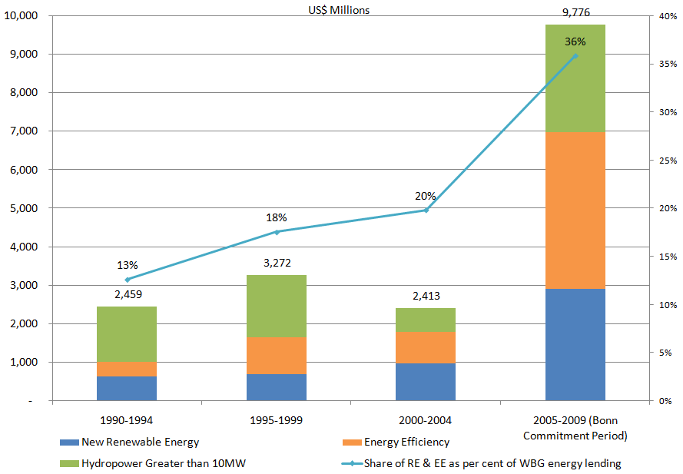
WB Group EE financing
World Bank, 2009

Slide 6
Int’l experiences – delivery models
Utility demand-side management (DSM)
Energy service companies (ESCOs)
Financing programs
Market transformation
Incentives, subsidies and grants

Slide 7
ESCO business models
High service/risk
Full service ESCOs design, implement, verify and get paid from actual energy saved (aka “Shared Savings”)
Energy supply contracting, take over equipment O&M and sell output at fixed unit price (aka “Chauffage”, “Outsourcing”, “Contract Energy Management”)
ESCOs w/third party financing, design/implement project, and guarantee minimum level of savings (aka “Guaranteed Savings”)
ESCOs w/variable term contract, act as full service ESCO, but contract term varies based on actual savings (e.g., “First Out Contract”)
ESCOs w/1-year contract, design/implement project, receives 60-70% of payment upon successful commissioning and the rest within 6-12 months
Supplier credit, equipment vendor designs, implements and commissions project and is paid lump-sum or over time based on estimated savings
Equipment leasing, similar to supplier credit except payments are generally fixed (based on est. energy savings)
Consultant w/performance-based payments, agent assists client to design/ implement project and receives payments based on project performance (fixed payment w/penalties or bonuses)
Consultant w/fixed payments, where consultant helps the client design and implement the project, offers advice and receives a fixed lump-sum fee
Low service/risk
Source: World Bank 2010

Slide 8
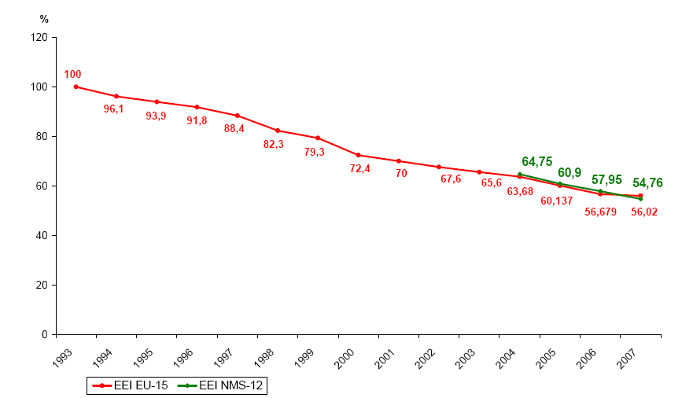
Market transformation
The Average EE Index (EEI) of European Refrigerators
Bertoldi & Atanasiu, 2009

Slide 9
What have we learned?
EE requires a long-term and dedicated focus
Western models can serve as reference points, but need to carefully adapt to local situations
Holistic market assessments are critical
Programs should be commercially-oriented, demand-driven and flexible
Balance policy frameworks, institutional arrangements, training, and implementation
Show results within 1-2 year to create credibility
Create strong incentives for all actors to actively participate
Launch marketing campaigns to ensure high participation
Follow-up technical support to address implementation hurdles and program/market evolution

Slide 10
Accelerating EE
Enact EE legislation and supporting regulations
  Signals government commitment
  Provides institutional mandates and funding mechanisms
Develop EE programs and set targets
  Creates lines of accountability
  Brings stakeholders together for common purpose
Build local capability
  Often most effective when “learning-by-doing”
  Includes successful marketing and education campaigns
Replicate and scale up
  Builds upon successful pilots, demos, models on a large, commercial scale
  Gov’t shifts from implementer to market organizer, advocate

Slide 11
Thank you!
Milan Popovic
E-mail: mpopovic2@worldbank.org
Tel: 3023 707

