Slide 1
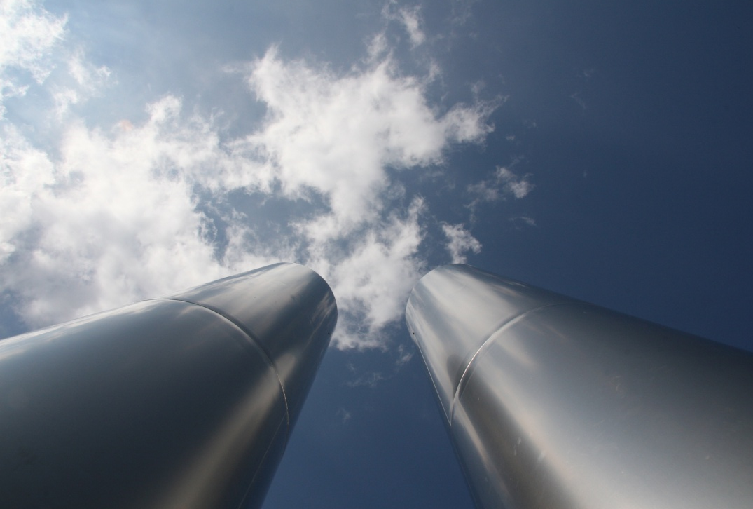
Costs & Benefit of Ecology Integration
Serbia - Austria
3rd Conference GREEN SERBIA, Belgrade, 29 February 2012
© Thomas Seegers – Fotolia.com

Slide 2
Challenges for Serbia to achieve European Ecology Integration
Air quality shall be improved (PM, SO₂, NO_{x}).
Water pollution: improvements in drinking water security necessary; (in particular) major towns, industry need waste water treatment;
Waste: About 60% of municipal solid waste is collected. Hazardous waste shall be collected separately, treatment plants need to be established.
Contaminated sites: clean-up necessary to protect ground water, air
Biodiversity: richness of species and ecosystems needs to be protected.
Source: National Environment Strategy 2007

Slide 3
Estimated costs for ecology integration in Serbia
Total cost of meeting requirements of environmental acquis estimated around €10.6 billion (between now and 2030); i.a.:
water: € 5.6 billion
waste: €2.8 billion
industrial pollution: €1.3 billion
Costs are typically related to implementation of EU „cost heavy directives“ (in part. UWWD, Landfill-D, LCP/Waste Incin./IPPC/IED)
Source: National Environmental Approximation Strategy for the Republic of Serbia (final draft June 2011)

Slide 4
Financing & Benefit of Ecology Integration
An important part of the costs are operational ones, which will have to be financed from public budgets, private sources and/or charges.
The need of additional financing from Serbian public budgets is estimated to be at a maximum at around €360 million in 2018.
The direct economic benefits arising from environmental compliance until 2013 should outweigh the costs by the factor of approximately 2,4.

Slide 5
Primary Public Sources for Funding of Environmental Protection Projects in Austria
Main Federal Government Funding Instruments:
Settlement Water Management Fund → drinking water supply & waste water treatment; approx. 130m pa (declining)
Domestic Environment Fund → today mainly energy and climate protection, waste, air; public budget, approx. 90 m€ pa (increasing)
Contaminated Sites’ Remediation Fund → waste tax, approx. 50 m€ pa (constant)
In addition: subsidies by provinces & municipalities

Slide 6
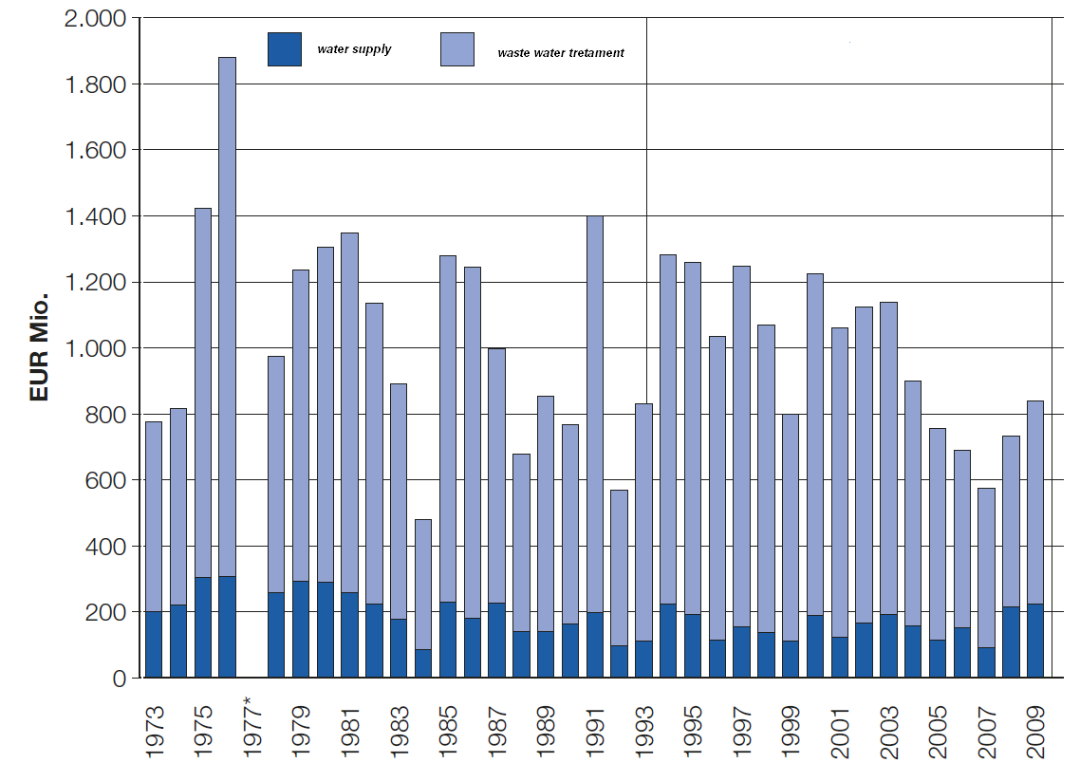
Sponsored investments in water management in Austria (1993-2009)
Total investment in WWT:
12.5 Billion €
(22,000 projects)
Fund‘s contribution: 4 Billion €
Total investment in water supply:
2.5 Billion €
(8,000 projects)
Fund‘s contribution:
500 m€

Slide 7
Investments sponsored by domestic environment fund (1993 – 2009)
Total investment (incl. waste)
4 Billion € (18.000 projects)
Fund‘s contribution: 800m€; out of which:
→ Renewable energy projects
Investment of 2 Billion € (12,000 projects)
Fund‘s contribution: 400 m€
→ Energy efficiency projects:
Investment of 600m € (5,000 projects)
Fund‘s contribution: 100 m€
→ Air quality projects
Investment 500 m€ (600 projects)
Fund‘s contribution: 100m €

Slide 8
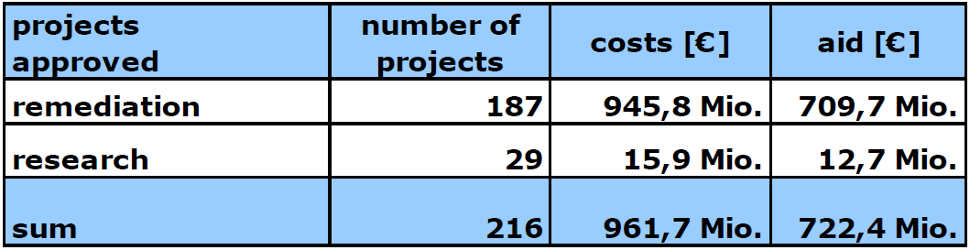
Funding of Contaminated Sites Remediation Projects (1993 – 2010)
Average percentage of funding: 75% of total costs
INCOME of fund due to waste tax ~ 50 Mio €/year
Landfilling 9,20 – 29,80 €/t (depending on type of landfill)
Waste storage residual waste 9,20 – 87 €/t (depending on waste type)
Backfilling of waste or export to landfill or backfilling 9,20 – 87 €/t (depending on waste type)
Waste incineration or export to waste incineration 8,00 €/t
Production of waste derived fuel or export … 8,00 €/t
Recycling in blast furnace or export … 8,00 €/t

Slide 9
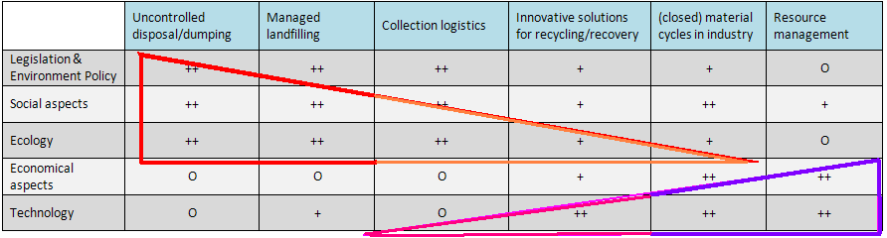

Model of „Six Maturity Stages“ in (national) waste management sector
Source: Saubermacher – Phasenmodell der Abfallwirtschaft

Slide 10
Economic relevance of the waste management sector in Austria
 | Private companies (including privatised public companies) | Municipal and public institutions | Total sector
Annual Turnover in Billion € | 4 | 1 | 5
Employees | 25,000 | 6,000 | 31,000
Number of companies | 850
GDP of Austria in 2009: ~ 274 Billion €
Source: Organisatorische Aspekte der österreichischen Abfallwirtschaft (Denkstatt 2009); Statistik Austria 2012

Slide 11
Thank you for your attention
Contact & Information:
Georg Rebernig
+43 1 31304 5524
georg.rebernig@umweltbundesamt.at
Umweltbundesamt
www.umweltbundesamt.at
Green Serbia
Belgrade■ 29.2.2012

Slide 12
Importance of legislation and enforcement
Geographical coverage of municipal waste collection in Austria increased significantly only after adoption of adequate waste legislation (~ after 1975)

Slide 13
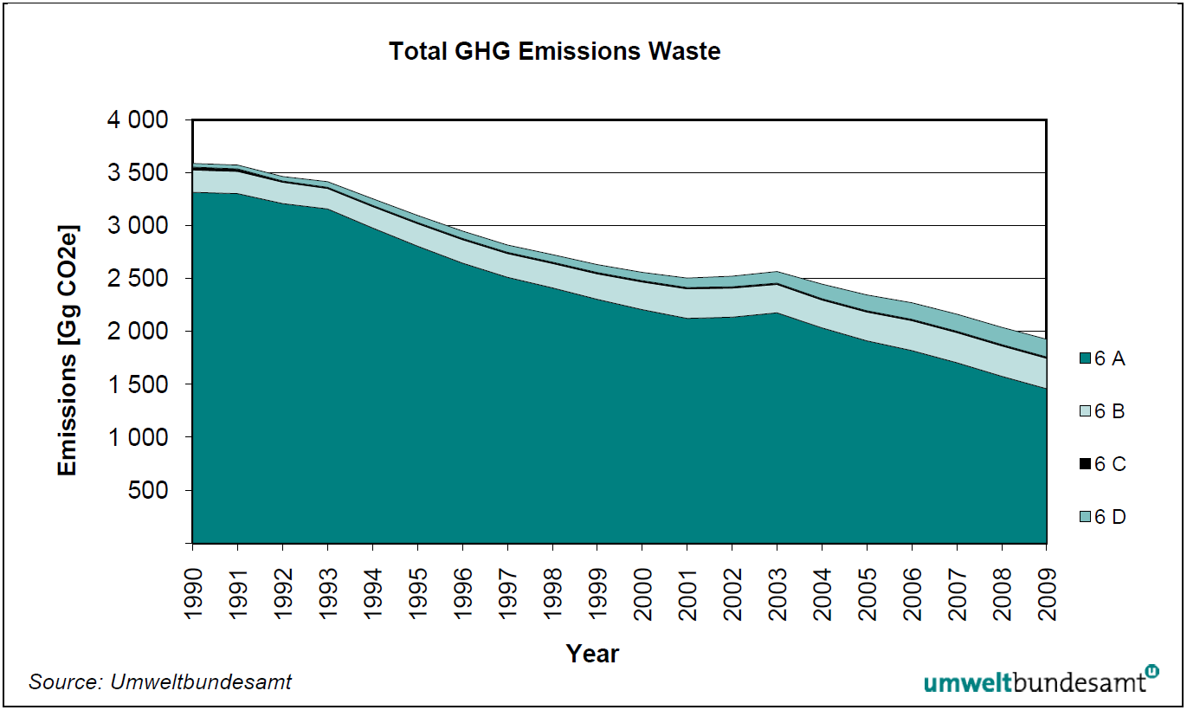
Benefits of adequate waste management
EU Emission Allowances Spotmarket:
~ 9 €/t CO2
(www.eex.com, 28.2.2012)
Source: Austria’s National Inventory Report (Umweltbundesamt 2011)

Slide 14
Benefits of adequate waste management
Secondary materials from recycling + energy from waste (reduced import dependence and reduced depletion of primary stocks)
Reduced land consumption
Reduced greenhouse gas emissions
Reduced emissions of and destruction by ecotoxic pollutants
Reduced ozone depletion, acidification and eutrophication
Protection of endangered species
Increased health
Job creation and increased turnover of waste management and recycling sectors
Reduced dust and noise emissions
Source: Bio Intelligence Service (2011): Implementing EU Waste Legislation for Green Growth. European Commission DG ENV. Brussels.

Slide 15
Treatment costs
Thermal treatment of MBT of residual waste:
  135 – 155 €/t
Composting, biogas from separately collected bio-waste:
  40 – 60 €/t
Source: denkstatt 2009

Slide 16
Costs of waste collection and transport
Waste from households, schools, commerce < 240 l/week
Waste from industries
Costs of municipal waste management per household: + 100 €/a (2009)
HH= Households, Source: denkstatt 2009

