Slide 1

ENERGETSKA EFIKASNOST
RAZVOJ ODRŽIVE ENERGIJE U JUGOISTOČNOJ EVROPI
18. oktobar 2013, Beograd
Prof. dr Dušan D. GVOZDENAC
University of Novi Sad, Faculty of Technical Sciences, Novi Sad, Serbia
i
Univerzitet EDUCONS, Sremska Kamenica, Srbija

Slide 2
Indicators are as follows:
Total primary energy supply per population [toe/capita]
Electricty consumption per population [kWh/capita]
CO₂ emission per population [tCO₂/capita]
GDP(ppp) per population [2005 US$/capita]

Slide 3
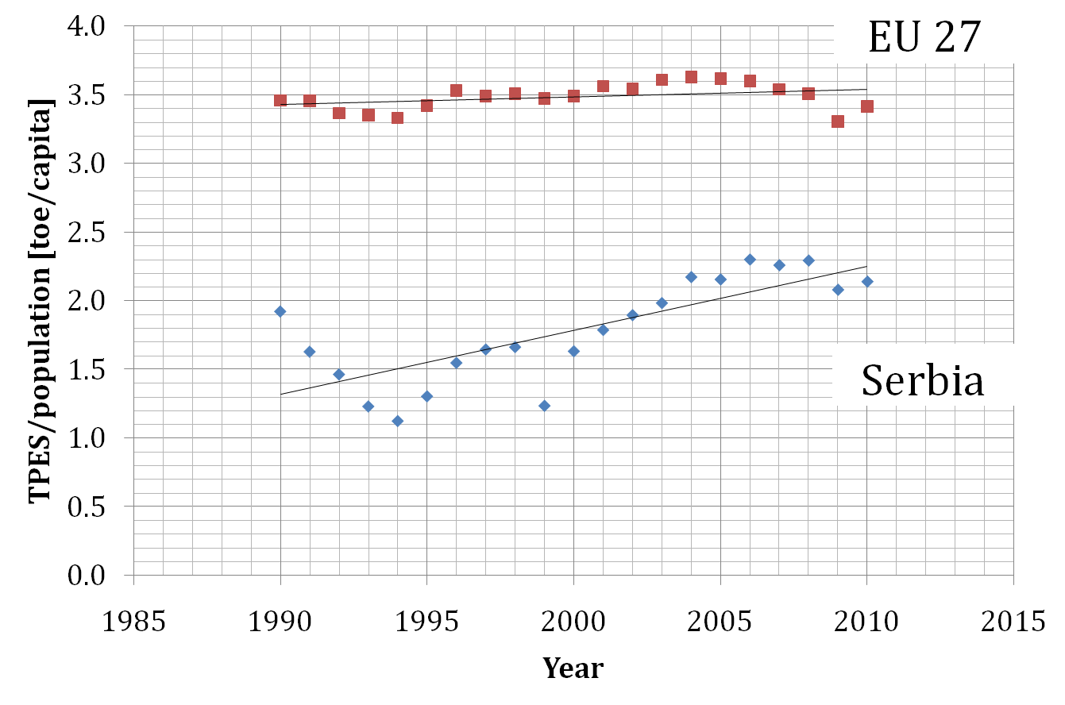

Slide 4
In the period from 1990 to 2010 , TPES per population in Serbia was growing while in EU 27 it was in stagnation
TPES per population in Serbia is much lower than in EU 27
The growth of TPES/population in Serbia causes concern in particular when it is well know that the economic activities are very slow.

Slide 5
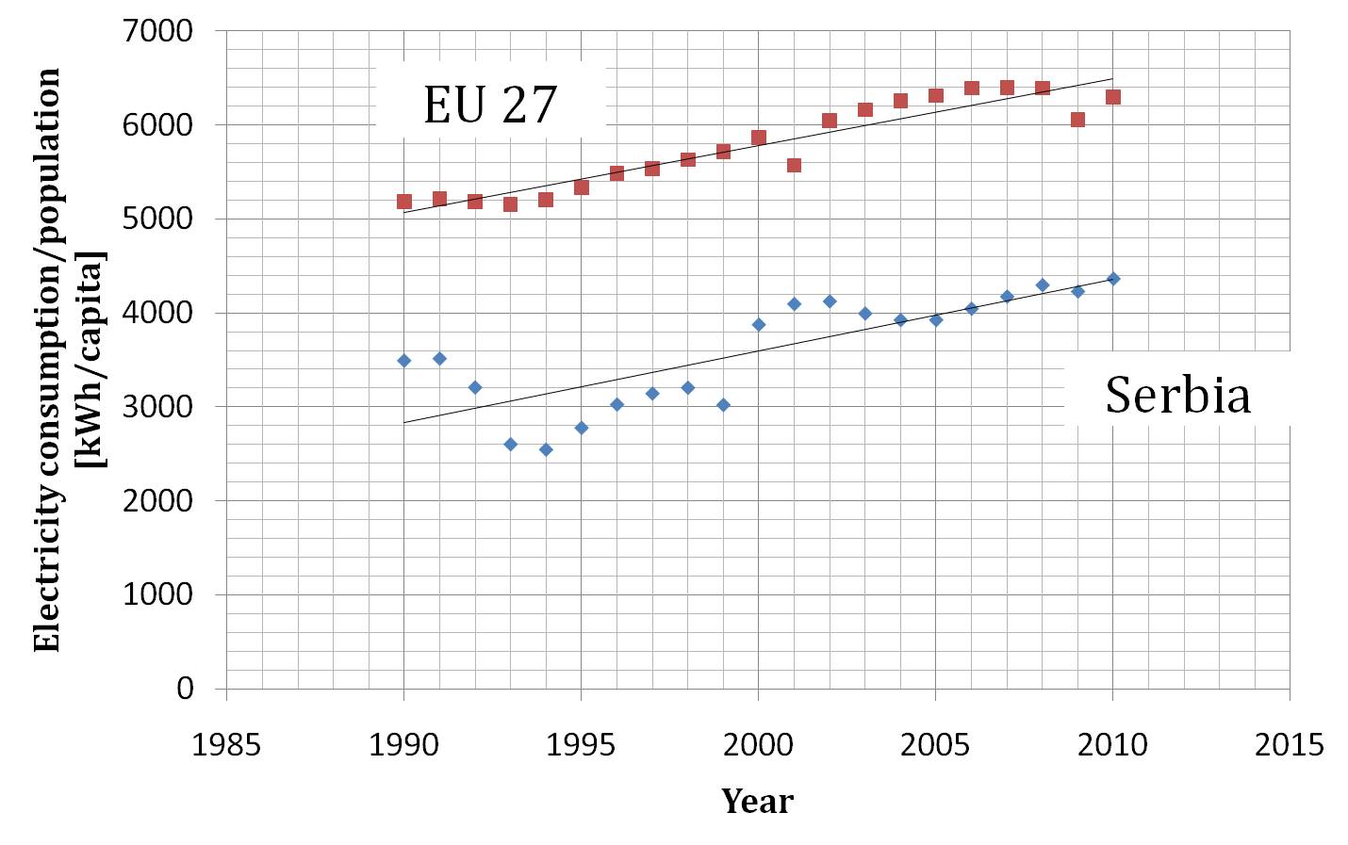

Slide 6
In the period from 1990 to 2010, the growing trend of electricity consumption is approximately the same as in EU 27
However, electricity consumption in EU 27 is much higher than in Serbia

Slide 7
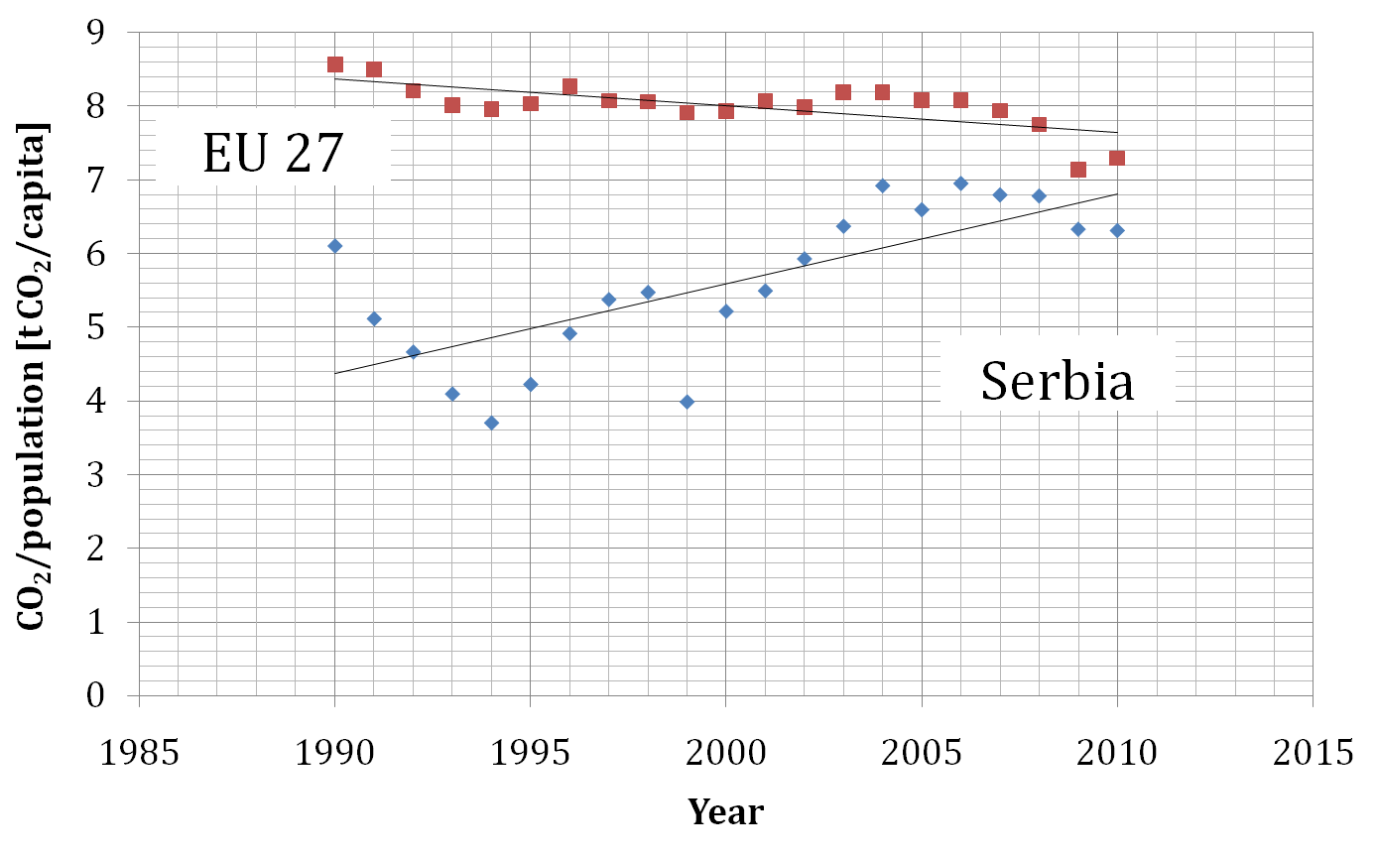

Slide 8
The growth of CO₂ emissions in Serbia is very obvious while in EU 27, it is falling.
Although CO₂ emission per capita is lower in Serbia than in EU 27, the growth of CO₂ emissions is not the consequence of economic growth but of further decline of energy efficiency and failure to utilize renewable energy sources.
The pronounced growth of CO₂ emissions indicates the absence of the utilization of renewable energy sources and the absence of effects of measures aimed at increasing energy efficiency.

Slide 9
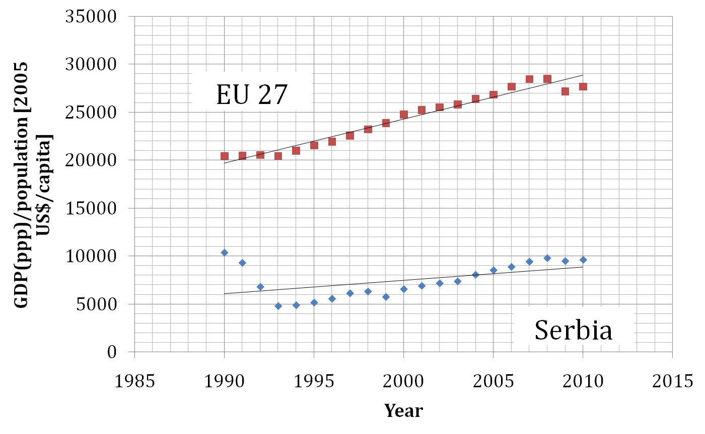

Slide 10
Everything becomes clear when GDP(ppp)/capita is compared
This indicator refers to economic activities which are at a very low level in Serbia compared to EU 27.
This means that increased consumption of TPES and electricity and consequential growth of CO₂ emissions can be the result of unfavorable overflow of energy consumption from productive to non-productive activities (public and residential sectors)
With all this, there is a decline in the number of population.

Slide 11
Basic social and economic characteristics for Serbia and EU 27
SERBIA | EU 27
Slight decline of population | Very slight growth of population
Slowdown of economic growth | Stable economic development
Considerable growth in primary energy consumption per capita | Stagnation in the consumption of primary energy per capita
Growth in electrical energy consumption per capita | Growth in electrical energy consumption per capita
Considerable growth in carbon dioxide emissions per capita | Considerable fall in carbon dioxide emissions per capita
GDP (PPP)/per capita = 9,608 US$ (2005) in 2010 | GDP (PPP)/per capita = 30,386 US$ (2005) in 2010

Slide 12
Results of Energy Efficiency Multi-Criteria Decision Analysis for Serbia
The practical implementation of energy efficiency policy is a very complex activity as it requires the fulfillment of a large number of criteria which differ by nature.
The consideration and evaluation of the effects of these activities represent, then, a multi-dimensional problem.
Multi-criteria analysis enables the consideration and evaluation of all aspects of energy efficiency policy in relation to defined criteria in an organized and systematic way and takes into account and assesses each individual criterion.

Slide 13
The following criteria are involved:
K1. Government goals and the achievement of objectives: long-term development of the energy sector; energy transition; lower import dependency; geographical dispersion of sources; compatibility of energy systems.
K2. Goals of the economy and the accomplishment of interests: cheap and accessible energy for the economy; opportunities for the ESCO (Energy Service Company) concept.
K3. Goals of public companies and plants and the achievement of defined tasks : efficiency of energy production and distribution; introduction of renewables; acceptable quality, price and diversity of energy; technical viability; cost effectiveness.
K4. Meeting social interests: reducing risks of energy system breakdown, lack of energy and pollution; advancement of health, safety and the environment.

Slide 14
Results of analysis (1/9)
Tech and Non-Tech | TASK (Energy policy options) | Criteria: | K1 | K2 | K3 | K4 | SUM
 |  | Weight of each criteria: | 0.16 | 0.28 | 0.47 | 0.09
Building construction | Upgrading building construction |  | 0.4 | 0.2 | 0.4 | 0.2 | 0.33
 | Implementation of energy services in buildings |  | 0.8 | 0.4 | 0.6 | 0.6 | 0.58
 | Implementation of administrative buildings project |  | 0.6 | 0.2 | 0.4 | 0.4 | 0.38
 | Promotion of highly efficient technologies |  | 0.8 | 0.4 | 0.4 | 0.4 | 0.46
 | Education and training |  | 0.8 | 0.2 | 0.2 | 0.8 | 0.35
 | Improvement of performances in existing private buildings |  | 0.6 | 0 | 0.2 | 0.6 | 0.25
 | Financial schemes |  | 0.6 | 0.8 | 0.8 | 0.6 | 0.75
 | Assessment of needs for human resources development |  | 0.4 | 0.2 | 0.4 | 0.2 | 0.33

Slide 15
Results of analysis (2/9)
Tech and Non-Tech | TASK (Energy policy options) | Criteria: | K1 | K2 | K3 | K4 | SUM
 |  | Weight of each criteria: | 0.16 | 0.28 | 0.47 | 0.09
Industry | Energy management |  | 0.4 | 0.2 | 0 | 0.6 | 0.18
 | Upgrading services in the area of RES and energy efficiency |  | 1 | 0.6 | 0.2 | 0.8 | 0.50
 | Production of electricity from RES |  | 1 | 0.4 | 0.2 | 1 | 0.46
 | Establishment of minimum standards for energy efficiency |  | 0.8 | 0.4 | 0 | 0.6 | 0.30
 | Acquiring new technologies and assessment of service life |  | 0 | 0.6 | 0 | 0.2 | 0.19
 | Intensified market transformation |  | 0.8 | 0.8 | 0.2 | 0.2 | 0.46
 | Monitoring market transformation and new incentives |  | 0.6 | 0.4 | 0.2 | 0 | 0.30
 | Assessment of needs for human resources development |  | 0.4 | 0.2 | 0 | 0.2 | 0.14

Slide 16
Results of analysis (3/9)
Tech and Non-Tech | TASK (Energy policy options) | Criteria: | K1 | K2 | K3 | K4 | SUM
 |  | Weight of each criteria: | 0.16 | 0.28 | 0.47 | 0.09
Electric power plants, thermal power plants and utilities | Development of incentive schemes in RES and energy efficiency |  | 1 | 0.6 | 0.8 | 0.4 | 0.74
 | Distributed heat and power production |  | 0.8 | 0.4 | 0.6 | 0.8 | 0.60
 | Connection to the public distribution grid |  | 0.4 | 0.4 | 0.6 | 0.6 | 0.51
 | “Green” certificate |  | 0.4 | 0 | 0.2 | 0.6 | 0.21
 | “White” certificate |  | 0.4 | 0 | 0.2 | 0.4 | 0.20
 | Carbon trading and certification issues |  | 0.2 | 0.4 | 0.4 | 0.2 | 0.35
 | Legislation, standards and norms for fuels |  | 0.8 | 0.6 | 0.8 | 0.4 | 0.71
 | Assessment of needs for human resources development |  | 0.4 | 0.2 | 0.4 | 0.2 | 0.33

Slide 17
Results of analysis (4/9)
Tech and Non-Tech | TASK (Energy policy options) | Criteria: | K1 | K2 | K3 | K4 | SUM
 |  | Weight of each criteria: | 0.16 | 0.28 | 0.47 | 0.09
Transport | Restructuring the whole national transport system |  | 1 | 0.4 | 0.6 | 0.6 | 0.61
 | Legislation, fiscal regime, fuel standards |  | 0.6 | 0.4 | 0.2 | 0.6 | 0.36
 | Supply chains for fuels and bio-fuels, and other fuels markets |  | 0.6 | 0.4 | 0.4 | 0.8 | 0.47
 | Reduction of demand for transportation |  | 0.2 | 0 | 0.2 | 0.4 | 0.16
 | Economic instruments and incentives |  | 0.6 | 0.2 | 0.6 | 0.4 | 0.47
 | Information, stimulation and education |  | 0.6 | 0.4 | 0.4 | 0.6 | 0.45
 | Alternative vehicle fuel market |  | 0.6 | 0.2 | 0.4 | 0.8 | 0.41
 | Assessment of needs for human resources development |  | 0.4 | 0.2 | 0.4 | 0.4 | 0.34

Slide 18
Results of analysis (5/9)
Tech and Non-Tech | TASK (Energy policy options) | Criteria: | K1 | K2 | K3 | K4 | SUM
 |  | Weight of each criteria: | 0.16 | 0.28 | 0.47 | 0.09
Energy policy, legislation and market transformation | Relevance chain for energy policy |  | 0.8 | 0.4 | 0.4 | 0.2 | 0.44
 | Energy laws and regulations with respect to sustainability |  | 1 | 0.6 | 0.6 | 0.4 | 0.64
 | Energy planning in urban and rural areas. |  | 0.8 | 0.2 | 0.6 | 0.6 | 0.52
 | Promotion of successfully implemented projects |  | 0.6 | 0.2 | 0.2 | 0.4 | 0.28
 | Training and establishment of a network for policy creators |  | 0.8 | 0.2 | 0.4 | 0.2 | 0.39

Slide 19
Results of analysis (6/9)
Tech and Non-Tech | TASK (Energy policy options) | Criteria: | K1 | K2 | K3 | K4 | SUM
 |  | Weight of each criteria: | 0.16 | 0.28 | 0.47 | 0.09
Sustainable energy development | Promotion of sustainable development and mobilization |  | 0.8 | 0.2 | 0.4 | 0.6 | 0.43
 | Planning utilization of RES and efficiency measures at the local level |  | 1 | 0.4 | 0.6 | 0.6 | 0.61
 | Establishment of conditions for development of local market |  | 0.8 | 0.6 | 0.2 | 0.4 | 0.43
 | Support for establishing local and regional agencies |  | 0.8 | 0.4 | 0.6 | 0.6 | 0.58
 | Training and establishment of a network for policy creators |  | 0.8 | 0.4 | 0.6 | 0.8 | 0.60

Slide 20
Results of analysis (7/9)
Tech and Non-Tech | TASK (Energy policy options) | Criteria: | K1 | K2 | K3 | K4 | SUM
 |  | Weight of each criteria: | 0.16 | 0.28 | 0.47 | 0.09
Financial mechanism and incentives | Investment schemes for supporting programs and projects |  | 0.8 | 0.6 | 0.8 | 0.4 | 0.71
 | Conditions for fair competition |  | 0.4 | 0.6 | 0.4 | 0.2 | 0.44
 | Micro-finance schemes |  | 0.6 | 0.6 | 0.6 | 0.4 | 0.58
 | Financial mechanism for stimulating innovative projects |  | 0.6 | 0.4 | 0.6 | 0.6 | 0.54
 | Training and establishment of a network for policy creators |  | 0.8 | 0.4 | 0.4 | 0.2 | 0.44

Slide 21
Results of analysis (8/9)
Tech and Non-Tech | TASK (Energy policy options) | Criteria: | K1 | K2 | K3 | K4 | SUM
 |  | Weight of each criteria: | 0.16 | 0.28 | 0.47 | 0.09
Monitoring and assessment | Monitoring and assessment of programs and measures |  | 0.4 | 0.2 | 0.4 | 0.6 | 0.36
 | Methods, indicators and modeling of future development |  | 0.6 | 0.2 | 0.4 | 0.6 | 0.40
 | Elaboration of mechanism for the exchange of experience |  | 0.6 | 0.2 | 0.6 | 0.4 | 0.47
 | Energy management based on advanced monitoring process |  | 0.6 | 0.4 | 0.6 | 0.6 | 0.54
 | Training and establishment of a network for policy creators |  | 0.6 | 0.4 | 0.4 | 0.4 | 0.43

Slide 22
Results of analysis (9/9)
Tech and Non-Tech | TASK (Energy policy options) | Criteria: | K1 | K2 | K3 | K4 | SUM
 |  | Weight of each criteria: | 0.16 | 0.28 | 0.47 | 0.09
Advertising and promoting | Dissemination of results, development and demonstration |  | 0.4 | 0.2 | 0.2 | 0.4 | 0.25
 | Exchange of knowledge regarding best projects |  | 0.4 | 0.4 | 0.6 | 0.6 | 0.51
 | Dissemination of programs and their results |  | 0.4 | 0.2 | 0.4 | 0.6 | 0.36
 | Campaigns promoting an energy sustainable society |  | 0.4 | 0.2 | 0.6 | 0.6 | 0.46
 | Training and establishment of a network for policy creators |  | 0.6 | 0.4 | 0.6 | 0.6 | 0.54

Slide 23
7. Conclusions
The national energy policy should be relied on the following:
  Ultimate and continuous promotion of energy efficiency in all energy sectors,
  Full use of renewable energy sources and reduced consumption of imported fossil fuels,
  Development of service providers sector in order to achieve previous objectives (production of insulation materials, boilers for the use of biomass, small plants for the production of biogas, solar collectors, etc.),
  Modification of economic and financial mechanisms aimed at the implementation of previous objectives.

Slide 24
Thank You

