Slide 1
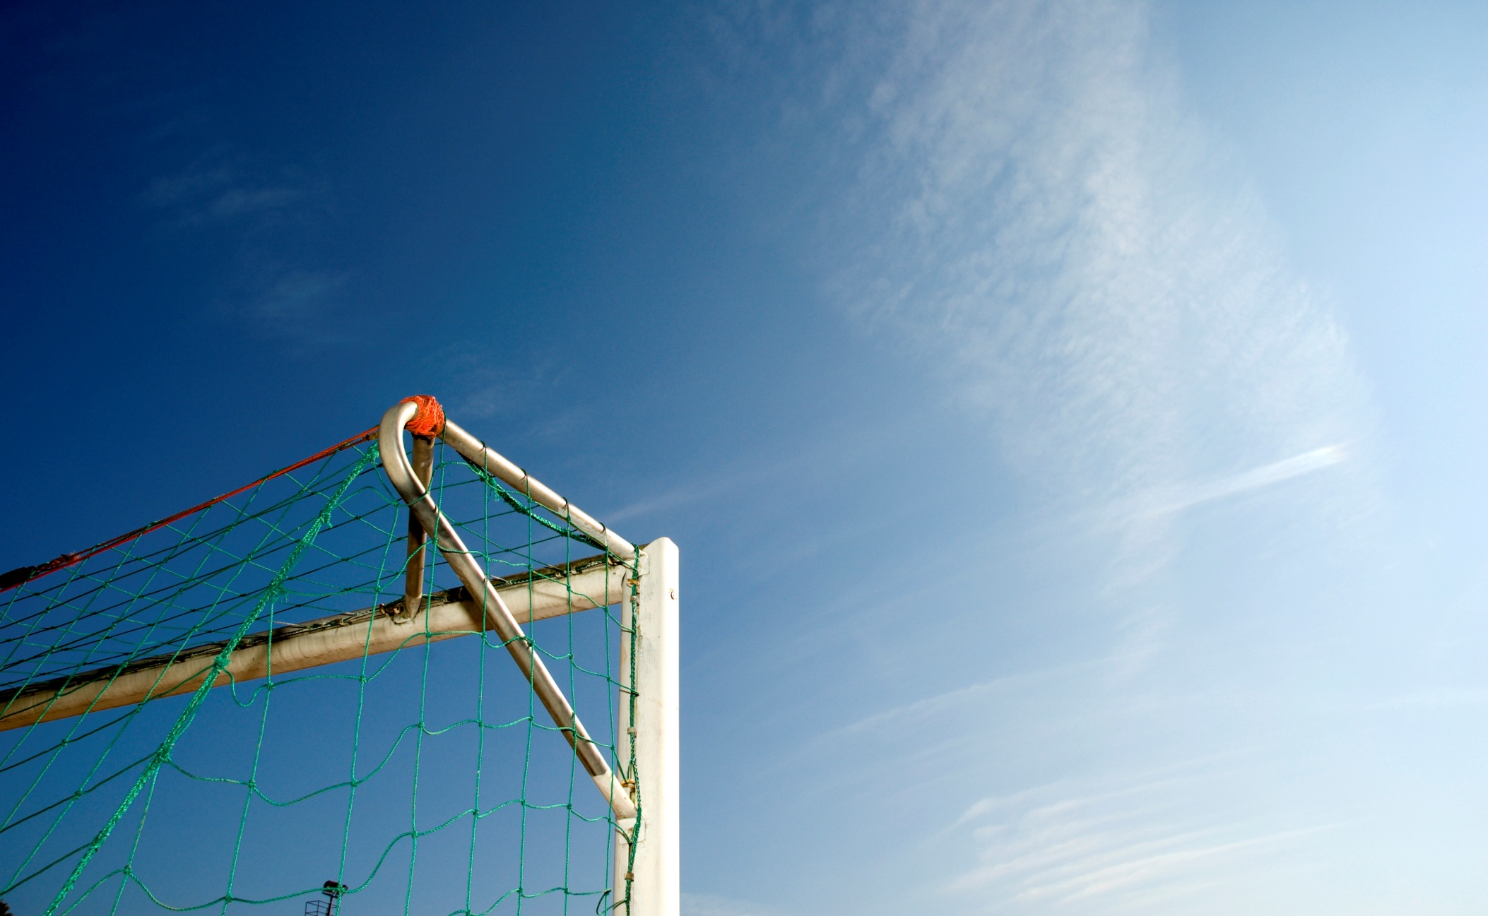
Climate and Energy Policy in the EU & Austria
Georg Rebernig, Environment Agency Austria
SUSTAINABLE ENERGY DEVELOPMENT
IN SOUTH EAST EUROPE
Belgrade, 18 October 2013

Slide 2
Content
Case for action: the Climate Crisis
European Framework for Climate and Energy Policy
Drivers for Austrian GHG emissions
Austrian Experiences Successes and Deficits
  Renewables
  Energy Efficiency

Slide 3
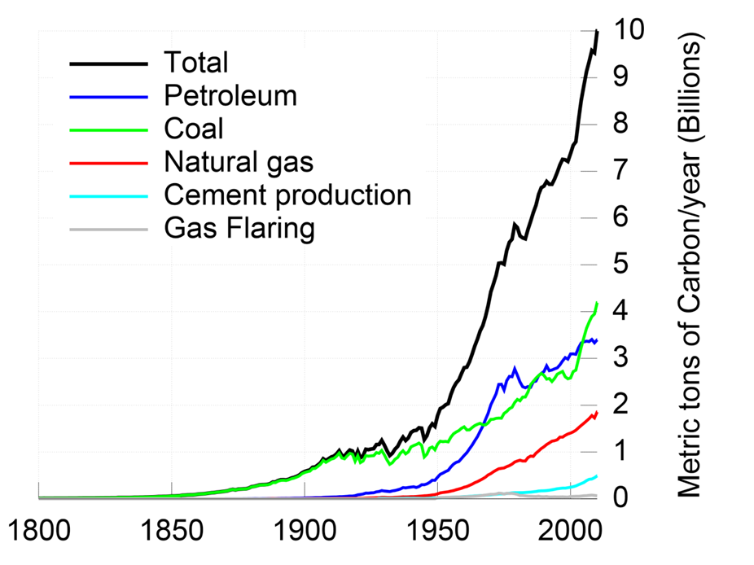
Atmospheric CO₂ levels increase..
.. mainly caused by use of fossil fuels
Notes:
The left figure shows the increase of CO2 in the atmosphere in the last 50 years. The data are taken from a monitoring site in Hawaii and show only one direction: Up! CO2 is a potent greenhouse gas which influences the radiative balance of the globe: The temperature is increasing. The annual variations are due to the uptake of CO2 by vegetation in summer, therby reducing CO2 levels in the atmosphere.
The right figure shows the most important driver for increasing CO2 levels: The use of fossil fuels. It started with the use of coal during the industrial revolution; in the 20th century, the use of oil increased dramatically, later also natural gas.

Slide 4
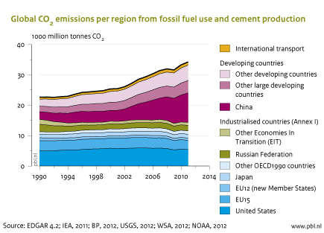
When China stepped in

Slide 5
Emission reduction needed for +2°

Slide 6
EU Climate and Energy Calender
2020 → “20-20-20”:
20 % reduction in GHG emissions (compared to 1990),
20 % share of renewables of gross final energy consumption
20 % increase in energy efficiency
2030:
EU Green paper: tries to integrate competitiveness, re-industrialisation and ambitious climate targets (RE-share: 30%; GHG-Emission Reduction recommended: -40%)
Consultation started; new “binding targets” proposal for 2030 expected in coming months
2050:
Minus 80% to minus 95% GHG emissions - Energy Roadmap & Roadmap to reach a low carbon economy
Notes:
In the EU, there is a clear legal framework for climate and energy policy up to 2020.
This is summarised by the acronym 20-20-20.
However, there are no binding regulations for post-2020. This is a clear deficit, since business and in particular the energy sector, needs predictable conditions.
Therefore, the EU Commission has issued a green paper on a possible policy framework for energy and climate until 2030.
Now we are expecting a new proposal for binding targets until 2030. We’ll see if this proposal will be made before the next election of the EU Parliament, which is due in May 2014.
For 2050, the EU Commission has published two roadmaps. The Energy Roadmap & Roadmap to a low carbon economy. These roadmaps show some paths to a 80 % reduction of European GHG emissions. Such a reduction will be necessary to keep the global increase of temperature within 2 °C.

Slide 7
Factors determining GHG emission trend in Austria from 1990 - 2011
Notes:
This graph shows the most important drivers for the GHG emission trend in Austria from 1990 to 2011. The red bars are those factor, which had an increasing influence. One is popoulation growth, and the most important one economic growth, displayed as the increase of GDP/capita. Both, population and economic wealth growth are political priorities in Austria and also Serbia. Therefore, we have to focus on those factors, which reduce GHG emissions. The three most important are a shift to renewables, the increase of energy efficiency and a shift within fossil fuels from coal and oil to gas (which is e.g., currently happening in the US.)

Slide 8
Austria‘s experience - Renewables
Electricity:
~ 70 % of electricity from renewables (#1 in EU28), mainly hydro; wind fast increasing
Green Electricity Act: Feed-in tariffs, separate objectives for PV, hydro, biomass and wind
All Energy:
34 % target for 2020
The share increased from 24 to 31 % from 2005 to 2011
New buildings: Subsidies are linked to use of renewables
Subsidies for switch from oil/gas to pellets for heating
Minimum content of biofuels in diesel and petrol fuel
Notes:
Austria has a long tradition in supporting renewable energy sources. Here a some instruments which we use.

Slide 9
Austria‘s experience – Efficiency
Objective: Stabilize final energy consumption at 1100 PJ from 2005 to 2020
Success in building sector (thermal insulation, nearly zero emission standard for new buildings)
Decrease in fuel consumption for new cars (but still 1/3 of final energy consumption is used for transport)
250 m Euro annual subsidies for energy efficiency & renewables measures
Support for environmental technology industry
Notes:
For energy efficiency, there is still a long way to go.
We have some progress in the building sector (where Austrian companies are leading in passive house technology), but thermal insulation is still not happening as fast as it should.
The traffic sector is still a major challenge. Austria is a transit country, and we suffer from increasing traffic. However, there are also small successes. E.g., Vienna has an increasing share of public transport a drop in motorization – a consequence of a very good supply of public transport.
We also spend a lot of money to support innovative industries; these investments pay off. We reduce our energy bill (mainly going to other world areas for fossil fuels) and boost our export orientated environmental technology industry.

Slide 10
Austria‘s environmental technology industry
Notes:
This figure shows you the development of key indicators of our environmental technology industry (blue) compared to the total material goods production.
In particular during the economic crisis in 2009, turnover, employment and exports increased significantly.

Slide 11
Austria‘s deficiencies
No decoupling of economic growth from energy consumption
Still no transposition of Energy Efficiency Directive into national legislation
Re-Vitalise Emission Trading System (on EU level) is urgently needed
No targets for post-2020
Make stronger use of economic instruments:
Reduce environmental harmful subsidies
Ecologic tax reform
Notes:
However, also Austria has to do a lot of homework. As an example, we still have not decoupled our economic growth from energy consumption.
Energy efficiency has not been in the focus as much as it has to be. There is still no strong lobby for avoiding energy consumption.
On a EU level, we have to re-vitalize the EU ETS. The current carbon price exerts no pressure to avoid the use of carbon intensive fuels and technologies.

Slide 12
The Way ahead…
Continued efforts to reach Global Climat Accord
Accelerate implementation of Climate & Energy Acquis
Continued transformation of the energy system
  Importance of electricity will continue to grow
  In partic. wind, PV: power transmission and storage
  Switch to low carbon fuels
  Promote efficiency in power generation (refurbishment), industry, buildings & housholds
  Promote public transport
  Promote eco-industry and innovation

Slide 13
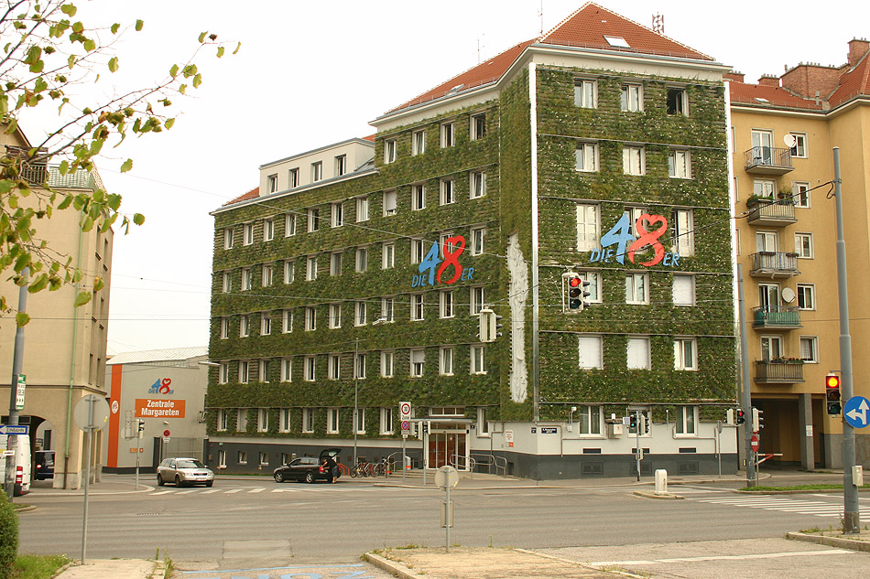
Let green houses flourish!

Slide 14
Contact & Information
Georg Rebernig
Managing Director
+43 1 31304 5424
georg.rebernig@umweltbundesamt.at
Federal Environment Agency
www.umweltbundesamt.at
Beograd ■ 18.10.2013

Slide 15
The heat in on…..
Notes:
This figure is derived from the recent 5th IPCC Assessment report. This report was published a few weeks ago and summarises the current knowledge on climat change.
It shows the observed an modelled trend of the temperature and the Ocean Heat Content (OHC). The blue area gives the predicted trend if the effect of anthropogenic emissions of GHG are not included in the model; there is no agreement between observations and modeled results; however, if the effect of anthropogenic emissions of GHG is taken into consideration, there is a good agreement between modeled effects and observations.

Slide 16
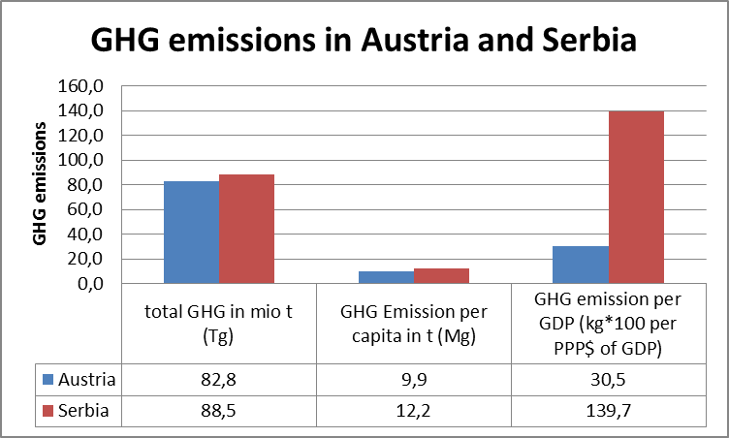
High eco-efficiency
Notes:
If the compare Serbia to Austria, we can seen that we have a similar total population, similar GHG emissions and comparable per capita emissions. However, we create more wealth per ton of CO2 emitted. This shows that high eco-efficiency can help you to keep your emissions down while having economic growth. However, it is important to have growth in sustainable sectors.

