Slide 1
RES/CHP Support Scheme in Slovenia
Irena Praček, Director, Energy Agency of the Republic of Slovenia
Conference: Sustainable Energy Development in SE Europe
Beograd, 18 October 2013

Slide 2
Content
The aim of the support scheme
Renewable energy sources and supporting technologies
Reference costs and the support level
Types of support and the process of obtaining the support
Effects of the support scheme

Slide 3
The aim of the support scheme
Why does the state grant the support for electricity produced from RES and high-efficiency CHP?
to compensate the difference between the production costs and revenues
incentives for investors
to achieve national objectives
Community Guidelines on State Aid for Environmental Protection (2008/C 82/01)
Basic grant allocation principle:
support may be granted only if the electricity generated in such facilities exceed the price of electricity from these facilities in the open electricity market.

Slide 4
Renewable energy sources and supporting technologies (1)
Eligible for support from RES → electricity produced by energy technologies using:
Hydropower (ecologically acceptable flow)
Wind power
Solar power (5 MW)
Geothermal energy (potential bonus for useful heat)
Biomass (min 60% efficiency, support depends on the type of biomass used)
Biogas (bonus for useful heat and higher share of liquid manure; restriction on the use of cereals)
Sewage gas
Biodegradable waste
Other sources that meet the definition of RES – are considered individually in determining support
SUPPORT FOR ELECTRICITY FROM RES– 15 YEARS
SUSTAINABILITY CRITERIA

Slide 5
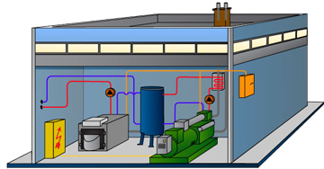
Renewable energy sources and supporting technologies (2)
Eligible for support from CHP → electricity produced by following energy technologies using:
Combined cycle gas turbine with heat recovery
Steam backpressure turbine
Steam condensing extraction turbine
Gas turbine with heat recovery
Internal combustion engine
Microturbines
Steam engines
All other technologies in accordance with the definition of CHP–individual evaluation of support
(reference fuel: wood biomass, natural gas - subject to useful heat,
75%, or 80% of fuel efficiency)
SUPPORT FOR ELECTRICITY PRODUCED IN CHP
– 10 YEARS
SUSTAINABILITY CRITERIA

Slide 6
Reference costs and the support level
What are the reference costs?
They define the level of support.
The annual costs of electricity production, in EUR/MWh
Cost estimation is based on technological and operational parameters, and the annuity method of valuing investment costs.
Investment costs (annual, determined by the annuity method) + operational costs
(amortization, operation, maintenance, insurance)
Taken into account return on equity – 12%, for solar power plants 6,4%
Determination of the costs is transparently explained in the Methodology for determining reference costs of electricity generated from renewable resources:
http://www.mg.gov.si/fileadmin/mg.gov.si/pageuploads/Energetika/Sprejeti_predpisi/Met_RS_OVE_2009.pdf
http://www.mg.gov.si/fileadmin/mg.gov.si/pageuploads/Energetika/Sprejeti_predpisi/Met_RS_SPTE_2009.pdf
The reference costs change yearly, their value depends on the reference prices for energy.
In case of other subsidies the reference costs are reduced.

Slide 7
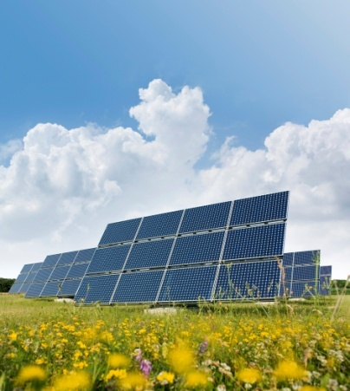
Types of support
Guaranteed purchase
Electricity
Centre for support
Guaranteed purchase
OR
Operational support
Own consumption
Electricity
Selling in the market
Operational support
Centre for Support

Slide 8
Procedure for obtaining support (1)
Requirements:
Generating facility in operation
Valid declaration for production facility (application filed at AGEN-RS, final decision)
Issuing and transferring guarantees of the origin to the Centre of Support (Application for Opening a Producer‘s Account)
Measurements of the net electricity generated (N=B-OC)
Age of production facility up to 15 years (RES) and up to 10 years (CHP)
Fulfilment of sustainability criteria

Slide 9
Procedure for obtaining support (2)
Application for obtaining a decision on support:
Information on a producer – an owner or a tenant of the production facility
Estimation of the production, data on beginning of operation
Information on metering devices, which measure net production
Data on all subsidies received
The type of the requested support
Operating permit, contract on the access
Decision
Contract for the provision of support – Centre for Support

Slide 10
Decision on granting support
Simple procedures – 2 months, evidence – taking procedures– 4 months (EA)
Entry to the support scheme in the month following the month of issued decision
Contract on the provision of the support in 15 days after final decision, yearly amendments to contracts
Type of support can be changed after two years, following changes possible every third year

Slide 11
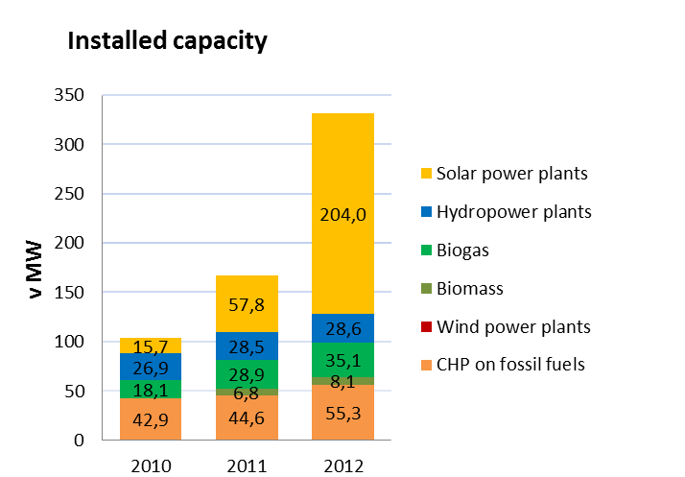
Effects of the support scheme (1)
Production
quite intensive development of the photovoltaic, other sources are lagging behind, especially water
increase in production per year, approx. 30%
significant increase in installed capacity in 2012, primarily due to photovoltaic

Slide 12
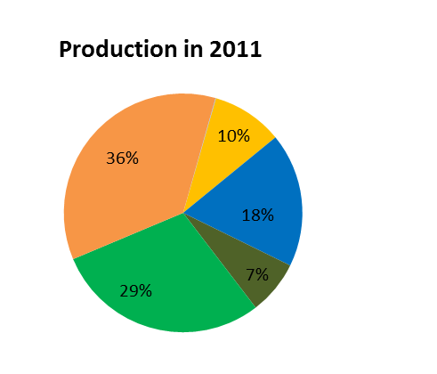
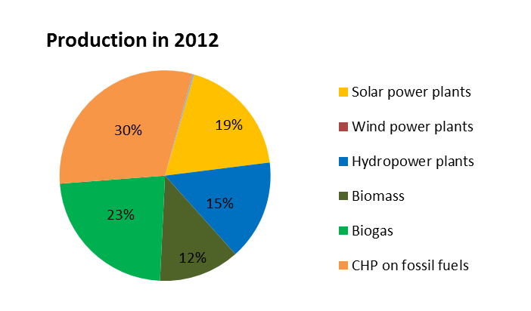
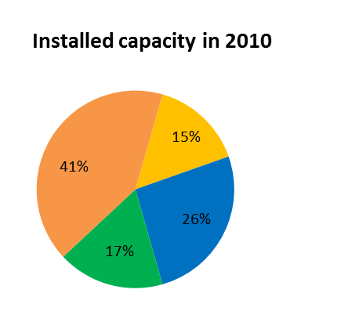
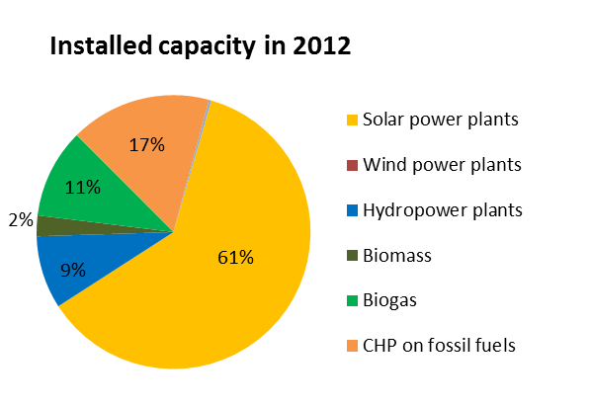
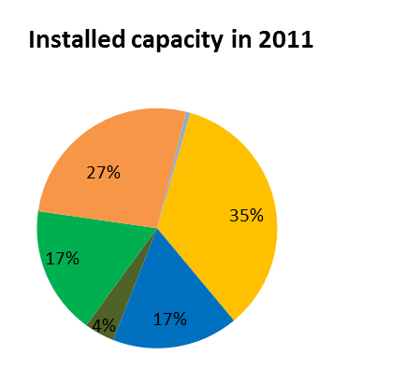
Effects of the support scheme (2)
Production
Comparison of the electricity production and shares of installed capacity of facilities in the support scheme according to the sources .

Slide 13
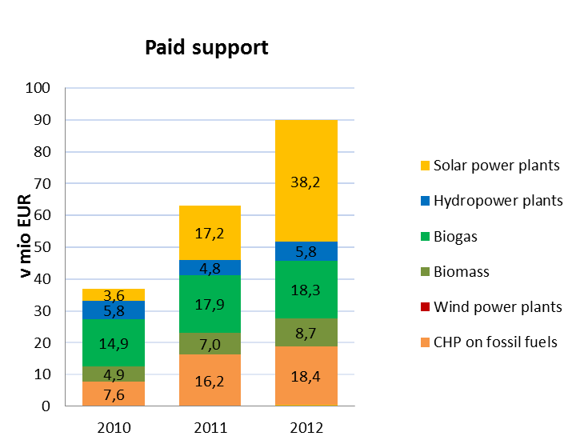
Effects of the support scheme (3)
Costs
Funded electricity from RES and CHP
estimated value of support for 2013 is 144 million euros

Slide 14
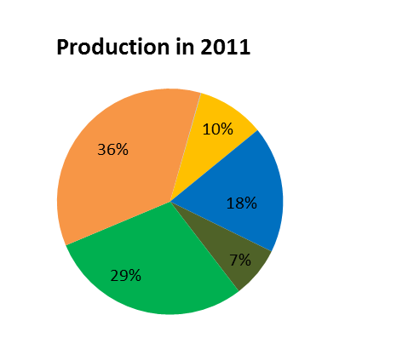
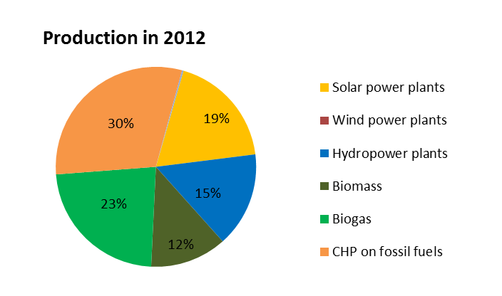
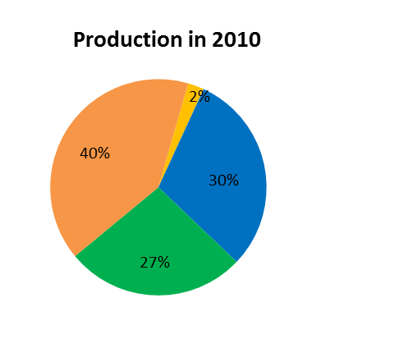
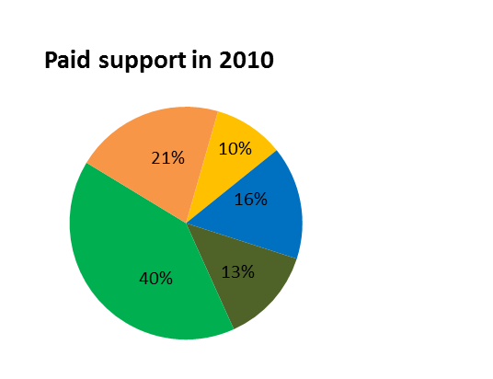
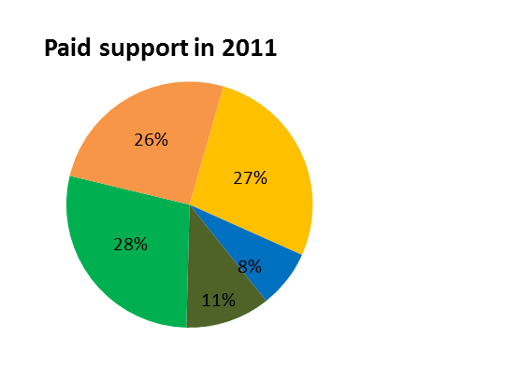
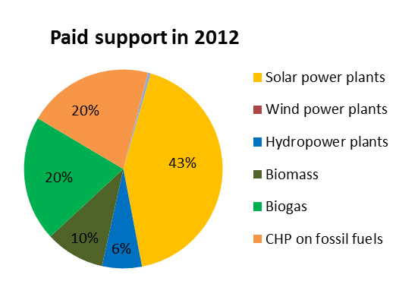
Effects of the support scheme (4)
Costs
Comparison of the shares of electricity production and shares of paid support in the support scheme according to the sources.

Slide 15
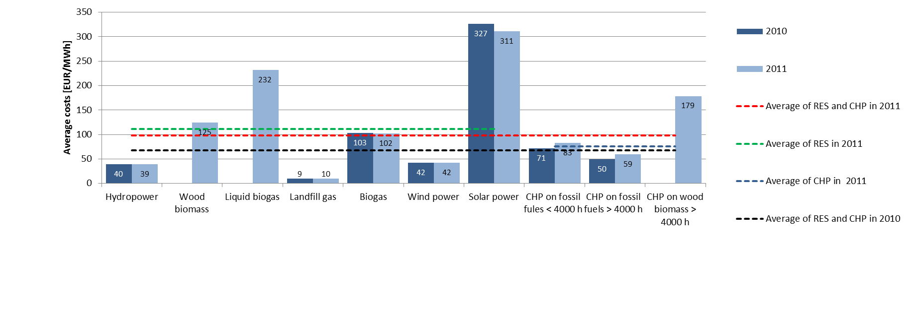
Effects of the support scheme (5)
Average costs for allocated support per unit according to the source of energy

Slide 16
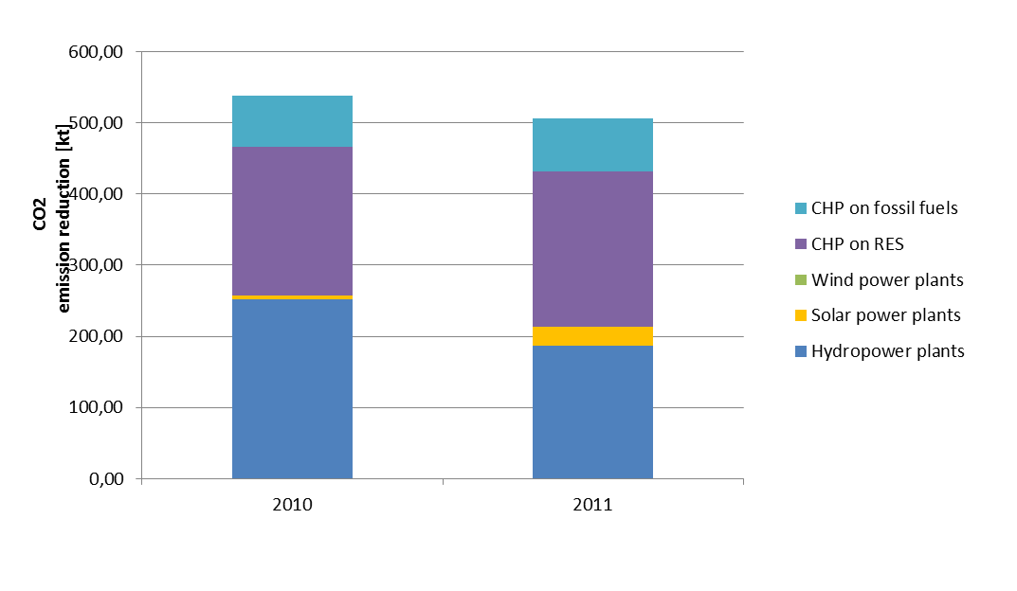
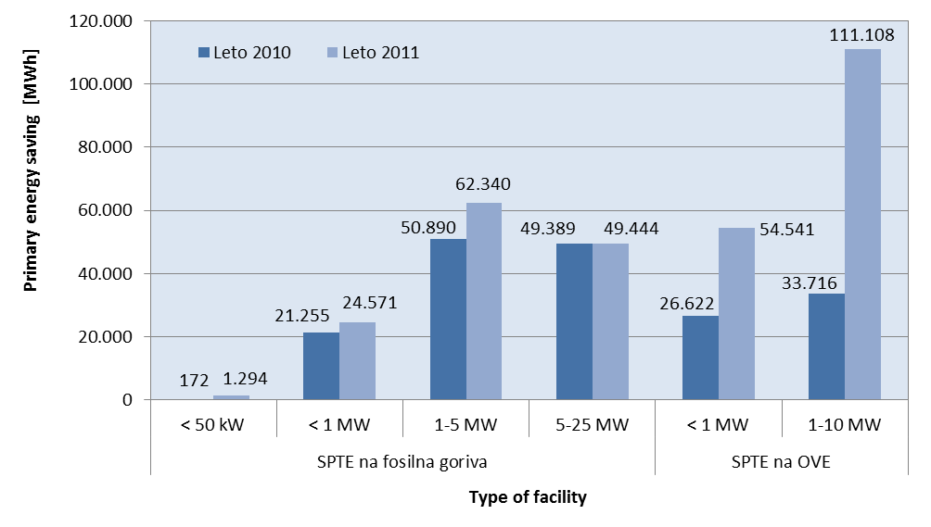
Effects of the support scheme (7)
Environmental benefits

Slide 17
Effects of the support scheme (8)
Economic benefits (in million euros)

Slide 18
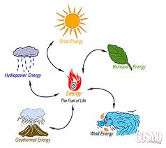
Effects of the support scheme (9)
Summary
MAIN INDICATORS |  | 2010 | 2011 | 2012
Production | GWh | 403 | 515 | 654
Installed capacity | MW | 104 | 168 | 332
Number of facilities |  | 953 | 1,503 | 2,543
Contribution to the target share of RES in the use of gross final energy consumption | Percentage point | 0.67 | 0.86
Contribution to the reduction of CO2 emissions | % | 1.2 | 1.7
Primary energy saving | GWh | 182 | 303
Costs for support | Million euros | 36.8 | 63.1 | 89.8
Average costs of support for RES and CHP Facilities on RES CHP facilities | EUR/MWh | 68 71 64 | 98 111 75 | 98 111 75
Share of electricity in the new scheme in the total production | % | 2.62 | 3.43
Investments in new facilities built in 2010 and 2011 | Million euros | 429
Employments on behalf of new facilities built in 2011 and 2011 Operation Manufacturing, construction, installation | Number people/year | 72 4,835

Slide 19
Thank you for your attention!

