Slide 1


Implementation of EU directives on energy efficiency
Sustainable Energy Development in South East Europe
Beograd 20. 2. 2015

Slide 2
History of EE

Slide 3
Brief intro
March 2007 that EU heads of state and governments endorsed the first EU “energy action plan”, with 3 core pillars: sustainability, security of supply, and competitiveness
Quntifiable targets : catchy 20 – 20 – 20 for year 2020
  20% reduction in EU GHG emissions of at below 1990 levels
  20% of EU energy consumption to come from renewable resources and
  20% reduction in primary energy use compared with projected levels, to be achieved by improving energy efficiency
Energy 2020 emphasises the urgent need to act in order to not only restructure the energy market in the EU and reach the climate targets, but also to stay competitive in the future.

Slide 4
Decade of policies
Range of policies and directives that transformed the energy market of member states:
  2002 Energy Performance of Buildings Directive (updated in 2010)
  2005 Ecodesign Directive and later Energy Labeling Directive (2010)
  2006 Energy End-Use Efficiency and Energy Services Directive
  The Energy Efficiency Directive (27/2012), approved in 2012, was the legislative result of the EEP that was published in March 2011 that repeals the Cogeneration Directive (2004) and the Energy End-Use Efficiency ....(2006).
The EED is ambitious. It is meant to fill the gap between existing framework Directives and national/international measures on energy efficiency and the 2020 EU target for energy savings.
It covers all sectors except transport, and includes, for the first time in an “energy efficiency” directive, measures for supply side efficiency.

Slide 5
importance of ee for EU
One of the pillars of the energy union

Slide 6
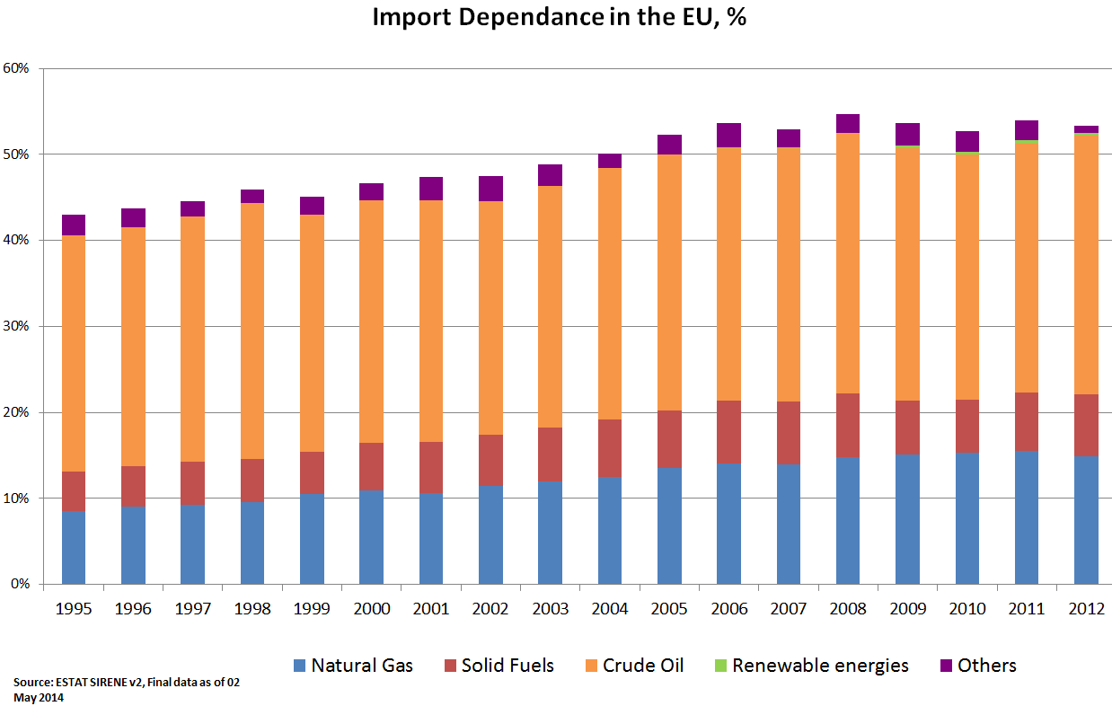
Resilience to supply disruptions
The EU energy system TODAY

Slide 7
Security of
supply
Competitiveness
Sustainability
Energy Union
Security
Research
&
Innovation
Internal
Energy
Market
Decarbonisation
Energy
Efficiency

Slide 8

Impact of ee

Slide 9
  EE MARKET DELIVER REDUCTION OF THE ENERGY NEEDED TO FUEL OUR ECONOMY
  Efficiency savings (1 336 Mtoe) provided more in 2011 to meet energy service demand than oil (1 200 Mtoe), electricity (552 Mtoe), natural gas (509 Mtoe) in IEA-11*

Slide 10
Investment in EE vs other energy supply
310 -360 b USD
(2012)
IEA EEMR 2013
Sources: BNEF, IEA

Slide 11
EE: an invisible power-house
Energy efficiency savings in IEA-11 countries rival TFC of major energy consuming countries and regions (e.g., EE improvements over the last 4 decades saved more energy in 2011 than TFC in EU)
  Australia
  Denmark
  Finland
  France
  Germany
  Italy
  Japan
  Netherlands
  Sweden
  UK
  USA
Notes:
Energy efficiency improvements over the past four decades have provided over 1300 Mtoe in energy savings in 2012.
Had the efficiency of our energy using stock from vehicles, buildings, appliances and manufacturing processes not improved since 1970, then in 11 IEA countries TFC would be 60% higher.
Energy efficiency investments are saving a major economy’s worth of energy demand and has therefore been an powerful downward driver on energy demand helping to offset the rise of emerging economies and their impact on the global energy system.

Slide 12
Support of EE
News on Energy Efficiency Calls

Slide 13

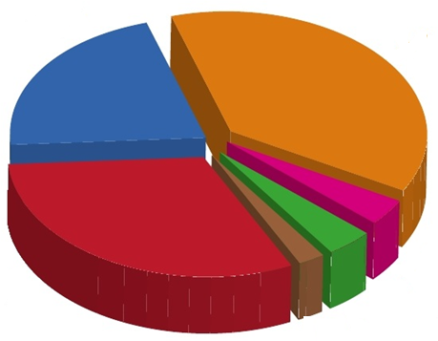





Horizon 2020 - over 68 B €
HORIZON 2020 BUDGET: 80 B€

Slide 14

Budget
2014-20
(EUR billion)
1. Health, demographic change and wellbeing | 7.5
2. Food security, sustainable agriculture and forestry, marine and maritime and inland water research and the Bioeconomy | 3.9
3. Secure, clean and efficient energy | 5.9
4. Smart, green and integrated transport | 6.3
5. Climate action, environment, resource efficiency and raw materials | 3.1
6. Inclusive, innovative and reflective societies | 1.3
7. Secure societies | 1.7
☞

Slide 15
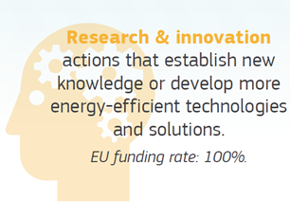
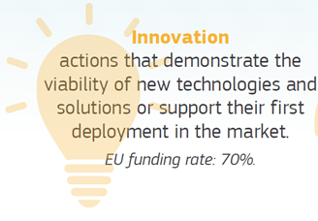
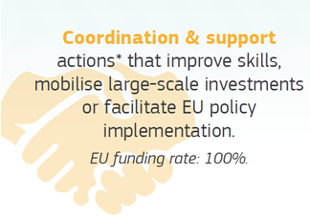
☞
3. Secure, clean and efficient energy
Main types of action
*building on Intelligent Energy Europe

Slide 16
☞
3. Secure, clean and efficient energy
Main Calls 2014 | Budget 2014 (M€) | Number of Proposals received
Energy Efficiency | 98 | 449
Smart Cities & Communities | 92 | 34
Low-Carbon Energy | 359 | 661
SME Instrument | 34 | 873
Total: | 583 M€ | 2017 prop.
A low success rate (9%)

Slide 17
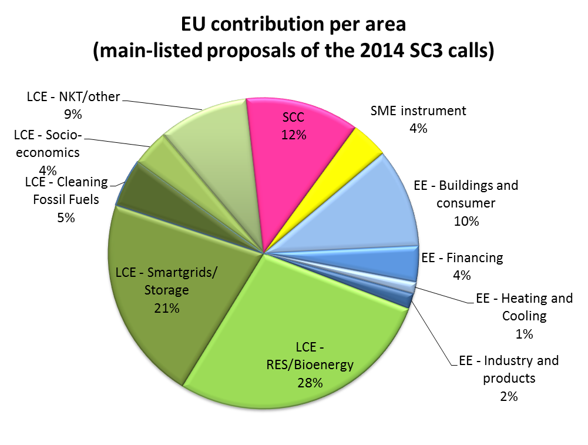

Slide 18

☞
3. Secure, clean and efficient energy
Calls 2015 | Budget (M€)
Energy Efficiency | 101
Smart Cities & Communities | 107
Low-Carbon Energy | 377
SME Instrument | 35
Fast Track to Innovation | 14
Other actions (e.g. Concerted Actions; tenders) | 58

Slide 19




☞
3. Secure, clean and efficient energy
Call 2015 | Budget (M€)
Energy Efficiency | 101
Funding areas?
Buildings & Consumers
Finance for Sustainable Energy
Heating & Cooling
Industry & Products

Slide 20




Code | Call 2015 Topics | Budget (M€) | Deadline
EE-02 | Design for new highly performing buildings | 9 | 4 Feb.
EE-18 | Heat recovery in large industrial systems | 10.6 | 4 Feb.
EE-06 | Demand response in blocks of buildings | 8 | 4 June
EE-11 | ICT for energy efficiency | 8.5
EE-13 | District heating and cooling | 5.3
EE-05 | Buildings renovation | 59.3 | 4 June
EE-07 | Capacity building of public authorities
EE-09 | Empowering stakeholders
EE-10 | Consumer engagement
EE-14 | Efficient heating and cooling
EE-15 | EU product efficiency legislation
EE-16 | Energy efficiency in industry
EE-17 | Innovation through large buyer groups
EE-19 | Attractiveness of investments
EE-20 | Project development assistance
EE-21 | Energy services and financial schemes
New
New
New

Slide 21
energy efficiency and some examples fro slovakia

Slide 22
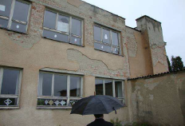
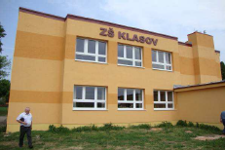
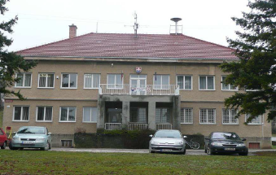
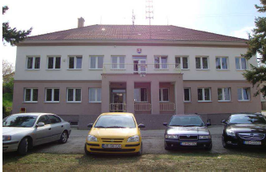
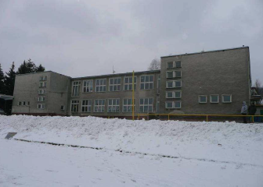
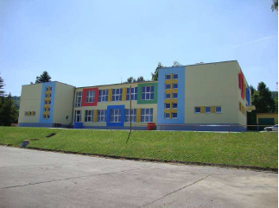
Before and after – public building refurbishment
Elementary school Klasov
City Hall Bojná
Elementary School Cerová

Slide 23
National EEAP
During the implementation of the 2nd EEAP (2011-2013), overall energy savings of 6 734 TJ of energy end use have been achieved – 81% of planned level, due to the missing long term financial support mechanism
Sector | Energy savings (EEU) 2011-2013 [TJ] |  | Total investments 2011-2013 [000 €]
 | Plan | Actual | Plan | Actual
Buildings | 1 754 | 4 055 | 1 079 065 | 3 718 880
Industry | 2 490 | 1 069 | 316 004 | 89 931
Public sector | 2 234 | 659 | 675 624 | 373 613
Transport | 899 | 278 | 2 291 502 | 2 144 144
Appliances | 985 | 668 | 160 783 | 129 895
Horizontal measures |  |  | 8 386 | 7 317
Total | 8 362 | 6 727 | 4 531 364 | 6 886 333

Slide 24
eeAP: goals for the near future
 | 2014-2016 |  |  | 2014-2020
 | Savings on EEU | Savings on PEU | Total investments | Savings on EEU | Savings on PEU | Total investments
 | TJ | TJ | 000 € | TJ | TJ | 000 €
Buildings | 3 087 | 4830 | 3 160 612 | 6 103 | 9 550 | 7 777 317
Industry | 2 569 | 4020 | 873 674 | 6 275 | 9 821 | 2 023 019
Public sector | 1 672 | 2616 | 390 834 | 3 577 | 5 598 | 827 504
Transportation | 576 | 901 | 3 868 046 | 2 346 | 3 672 | 7 795 499
Appliances | 737 | 1154 | 119 886 | 1 764 | 2 760 | 287 897
Horiz. measures | 20 | 31 | 22 768 | 72,00 | 113 | 54 711
Transf., tansp.& dist. | 0 | 2 422 | 326 575 | 0 | 5 701 | 823 940
Total | 8 661 | 15 975 | 8 762 395 | 20 137 | 37 214 | 19 589 886
% of the plan | 85 % | 100 % | - | 84 % | 100 % | -

Slide 25
EEAP Conclusions
Key enabler 1: stable and predictable source of financing of these measures.
Key enabler 2 : Consistency -expectation for reaching 100% of planned savings of the primary energy use would be realistic only under assumption that all planned investment into EE measures on side of transformation, transfer, and distribution of energy will be executed (and with strong participation of the private sector)
Key enabler 3 : Utilization of existing and using the new financial schemes will be mandatory to achieve energy savings, their improvement and monitoring.
For reporting the energy savings there is a need for reliable monitoring.

Slide 26
Thank you

