Slide 1

ENERGY POLICY OF EU AND INFLUENCE ON SEE ELECTRICITY MARKET
Dragan Vlaisavljevic, Februar 2015

Slide 2
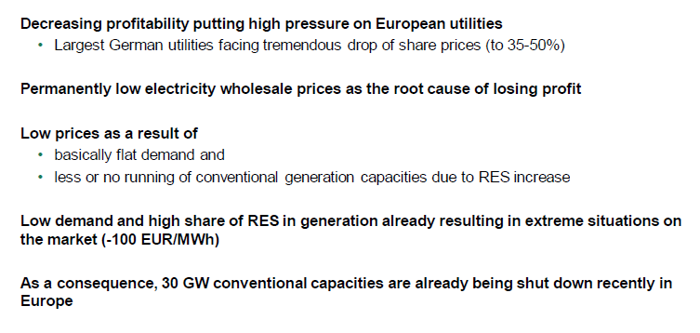
EU PRESENT SITUATION

Slide 3
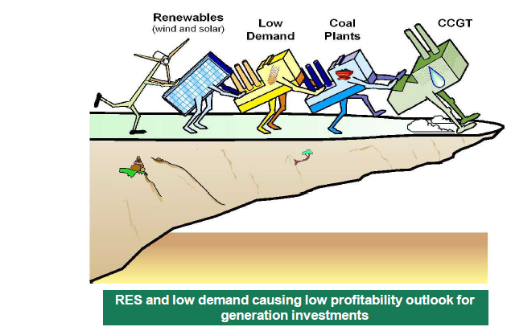
EUROPIAN CASE

Slide 4
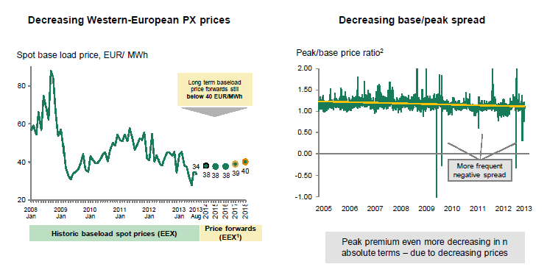
EUROPIAN CASE

Slide 5
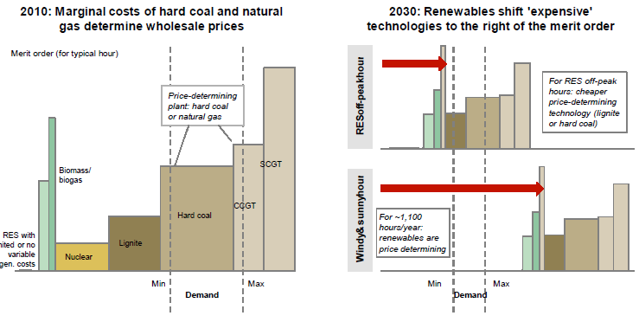

Slide 6
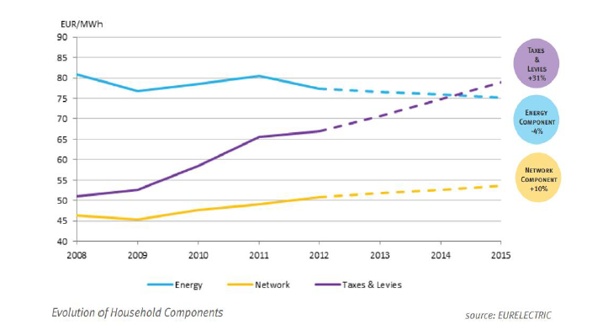
RETAIL PRICES ARE ON THE RISE

Slide 7
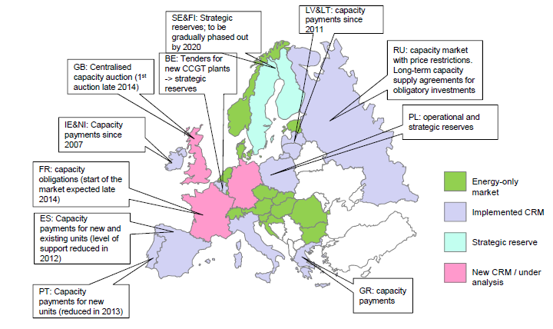
CAPACITY MARKET

Slide 8
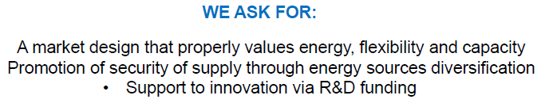

Slide 9
New Pump Storage Hydro Power Plant (“PSHPP”) in Serbia (1/2)
to improve electricity system reliability and at the same time enhance higher penetration of other intermittent renewable energy sources in the power network, such as wind and solar.
In that sense, construction of PSHPP that can provide different ancillary services to the power system, including balancing service, represents most efficient way of eliminating or mitigating potential balancing problems.

Slide 10
New Pump Storage Hydro Power Plant (“PSHPP”) in Serbia (2/2)
Development of the Market Study that will offer long-term forecast (20-25 years covering quarterly and annual values of all analyzed parameters) of specific electricity market prices relevant for PSHPP cash-flow calculation.
The Market Study will be based on detailed modeling of the regional electricity market, including identification of possible bottlenecks in cross-border transmission capacities, and contain detailed description of scenarios.

Slide 11
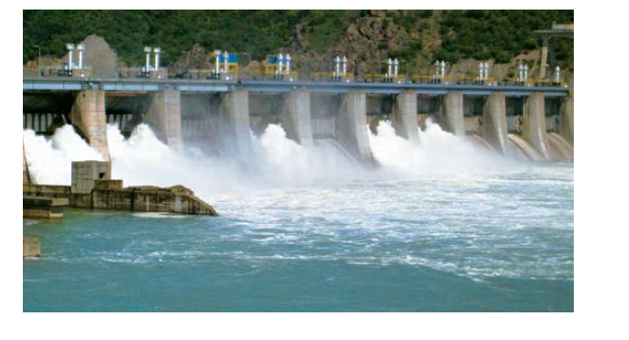
THANK YOU

