Slide 1
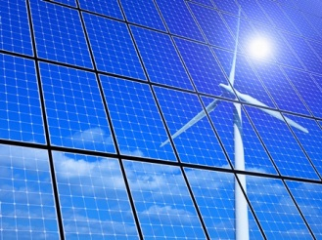
Options for climate friendly technologies for power generation and their related costs and potential environmental impacts
Sustainable Energy Development in Southeast Europe
© Eyematrix - Fotolia.com

Slide 2
EU Climate Strategy
2020 climate and energy package
  20% reduction in EU greenhouse gas emissions from 1990 levels
  Raising the share of EU energy consumption produced from Renewable Energy Sources (“RES”) to 20%
  20% improvement in the EU's energy efficiency.
  2030 framework for climate and energy policies
  Reducing greenhouse gas emissions by at least 40%
  Increasing the share of renewable energy to at least 27%
  Increasing energy efficiency by at least 27%
  Reform of the EU emissions trading system
    Industry: allocation
    Power generation: auctioning
Source: http://ec.europa.eu/clima/policies/

Slide 3
Serbia's RES Strategy for 2020
National Renewable Action Plan
Increase overall use of RES to 27%
Gross Electricity Consumption: 35 TWh →
  additional 3.7 TWh from RES (additional installation: 1.1 GW)
Heating and cooling sector → additional 1.7 TWh from RES
Increase use of RES in transport sector to 2.9 TWh

Slide 4
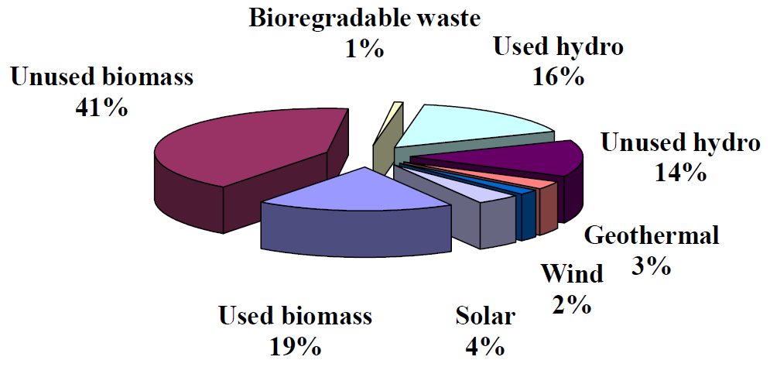
Renewable Energy Sources in Serbia
Source: National renewable energy action plan of the Republic of Serbia; https://www.energy-community.org/
Notes:
GEC = gross electricity consumption

Slide 5
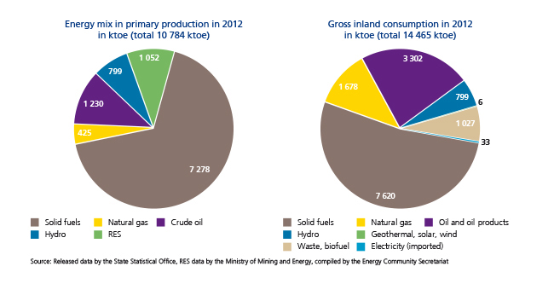
Status Quo in Serbia
Energy from renewable energy sources (RES) <20%
Biomass is mainly used as firewood in households
~4 GW capacity in large combustion plants older than 30 years using lignite without effective flue gas treatment
Source: National renewable energy action plan of the Republic of Serbia, Biomass consumption survey for energy purpooses in the energy community, www.energy-community.org
Notes:
Primary production = Primärenergieerzeugung
Als Primärenergieerzeugung wird jede Gewinnung von Energie in nutzbarer Form aus natürlichen Quellen bezeichnet, also die Ausbeutung natürlicher Quellen wie Kohleminen, Rohölfelder und Wasserkraftanlagen bzw. die Erzeugung von Biokraftstoffen.
Die Umwandlung der Energie von einer Form in eine andere, z. B. die Strom- bzw. Wärmeerzeugung in Wärmekraftwerken (durch Verbrennung von primären Energiequellen) oder die Koksproduktion in Koksöfen, ist keine Primärerzeugung.
Gross inland consumption = Bruttoinlandsverbrauch
Der Bruttoinlandsverbrauch an Energie, verkürzt auch als Bruttoinlandsverbrauch bezeichnet, ist der gesamte Energiebedarf eines Landes oder einer Region. Der Wert entspricht der Menge an Energie, die notwendig ist, um den Inlandsverbrauch der betrachteten geografischen Einheit zu decken.
Der Bruttoinlandsverbrauch an Energie umfasst:
den Eigenverbrauch der Energiewirtschaft,
Netz- und Umwandlungsverluste,
den energetischen Endverbrauch sowie
statistische Differenzen (die durch die Zahlen zum Primärverbrauch und zum energetischen Endverbrauch noch nicht abgedeckt sind).
Im Bruttoinlandsverbrauch nicht enthalten ist die Energie (Öl) für den grenzüberschreitenden Seeverkehr grenzüberschreitenden Seeverkehr (Bunker).
Der Bruttoinlandsverbrauch wird wie folgt berechnet: Primärerzeugung + rückgewonnene Energieprodukte + Nettoeinfuhren + Bestandsveränderungen – Bunkerbestände.
Der Unterschied zwischen dem Bruttoinlandsverbrauch an Energie und dem Brutto(energie)verbrauch besteht darin, dass im Bruttoenergieverbrauch auch der Umwandlungsausstoß (Strom oder Wärme aus anderen Energiequellen) enthalten ist. Der Bruttoenergieverbrauch ist demnach ein produktspezifischer Verbrauch, der nicht den Primärenergiebedarf widerspiegelt.

Slide 6
Options to enhance RES in Power Generation
Investment costs for flue gas treatment for existing lignite-fired power plants estimated to 700 mil.€ →
Replacement of old lignite-fired power plants that have low energy efficiency by power generated from renewable energy
Use funding for
  Wind energy
  Solar energy for heating and photovoltaic
  District heating and cooling
  Combined heat and power plants
  Hydro power plants
Source: Study on the Need for Modernization of Large Combustion Plants in the Energy Community

Slide 7
Considerations for Use of RES
Local and regional needs and potentials
  Local economic structure (agriculture, industry, tourism, urban areas,…)
  Local resources (sun, wind, forests, biomass from agriculture, rivers, mountains, soil,…)
  Creation of new jobs
  Feasibility and future cost effectiveness
    Cost & advantages for energy from RES
    Funding to bring RES into market
    Goal: marketable energy from RES → viable business models
investment climate & legal certainty
  Higher demands on the electricity grid (technical, management)
    More energy from RES
    Decentralized power generation (solar, wind, SHPP, buildings…)
    Volatility in production (wind, solar)

Slide 8
Austria - Output of Green Electricity
Notes:
Einspeisemenge von geförderten & nicht geförderten neuen Erneuerbaren Ökostromanlagen

Slide 9
Austria – Green Electricity Law
(Ökostromgesetz 2012)
Enacted 2003, several amendments since then
Eliminate imports of electricity generated by nuclear power by 2015
Increase capacity/production from 2010 to 2020 by 4.4 GW/10.5 TWh (current capacity: ~24 GW; gross national electricity consumption: 74 TWh):
Hydropower: 1,000 MW (≙4 TWh)
Wind: 2,000 MW (≙4 TWh)
Biomass and biogas: 200 MW (≙1.3 TWh)
Solar energy: 1,200 MW(≙1.2 TWh)

Slide 10
Austria - Funding
green electricity flat charge (Ökostrompauschale )
  Flat surcharge per year, set on a yearly basis
green electricity subsidy (Ökostromförderbeitrag )
  Percentage surcharge, set on a yearly basis
  Cost cap for low-income households
  Sales value of green electricity: 300 m €, additional funding: 800 m €
 | Household (3,500 kWh) |  |  | Industry (12 MW; 55,000 MWh)
 | 2012 | 2013 | 2014 | 2012 | 2013 | 2014
Flat charge | 11 € | 11 € | 11 € | 35,000 € | 35,000 € | 35,000 €
Subsidy | 26.5 € | 42.5 € | 57 € | 114,274 € | 206,156 € | 224,650 €
Guarantees of Origin | 0.5 € | 0.5 € | 0.4 € | 8,250 € | 8,250 € | 5,500 €
Turnover taxes | 8 € | 11 € | 14 €
Total | 46 € | 65 € | 82 € | 157,524 € | 249,406 € | 265,150 €
Cent/kWh | 1.31 ct | 1.86 ct | 2.34 ct | 0.29 ct | 0.45 ct | 0.48 ct
Source: Ökostrombericht 2014

Slide 11
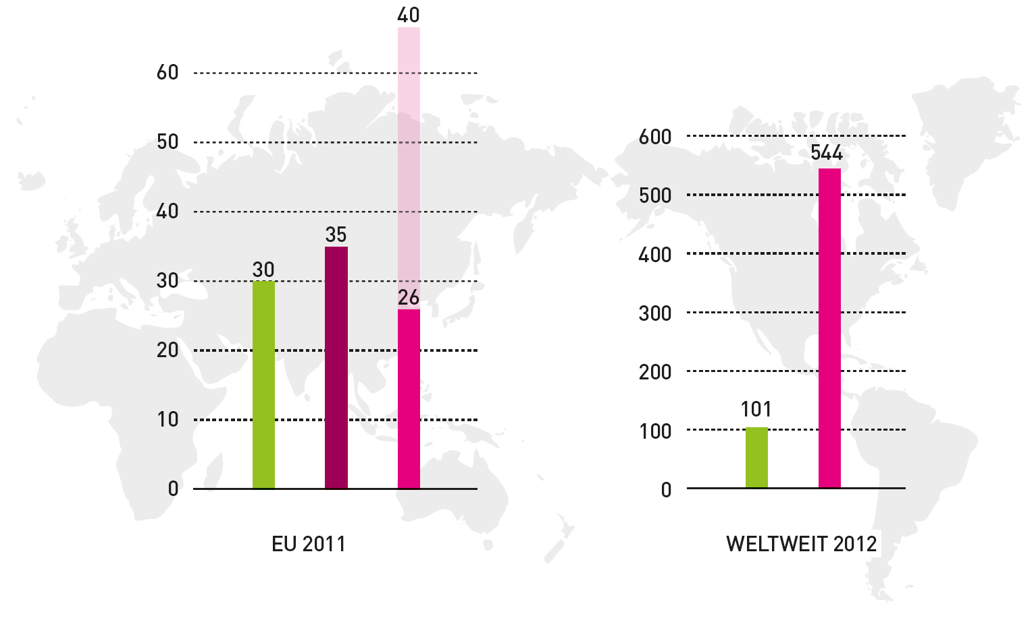

Support for Energy Production
Subsidies for
Renewable energy
Nuclear energy
Fossil energy
Health costs due to
fossil energy usage
EU 2011
bn. €
WORLDWIDE 2012
bn. US$
Renewable energy needs support, but nuclear and fossil energy already get support. Although differences in the EU are moderate compared to worldwide situation, renewable energy can save health and risk costs related to nuclear and fossil energy.
Source: Faktencheck Energiewende, Inventory of Estimated Budgetary Support and Tax Expenditures for Fossil Fuels, OECD 2013, World Energy Outlook 2013, Paris November 2013

Slide 12
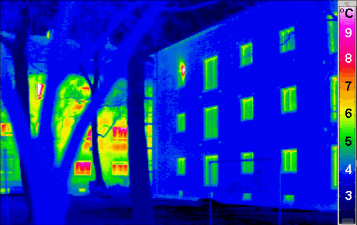
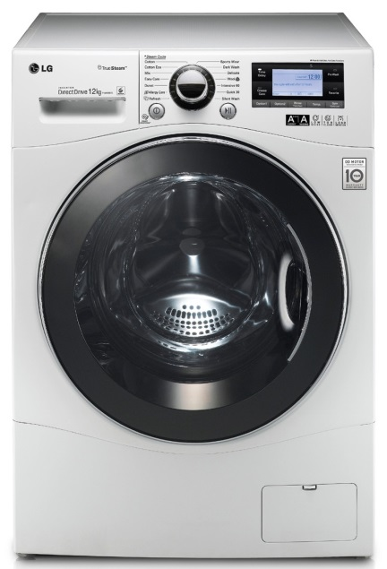
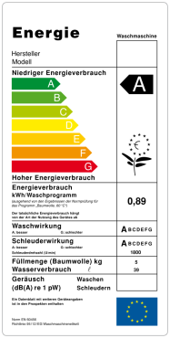
  Increase in energy efficiency
RES alone will not suffice to reach goals → key role of energy efficiency
Energy Efficiency Directive (2012/27/EC) – Austria: Energy Efficiency Law
Energy distributors and retail energy sales companies have to implement new savings each year of 1.5% of the annual energy sales to final customers or pay a fine

Slide 13
Contact & Information
Georg Rebernig
+43 1 31304-5424
georg.rebernig@umweltbundesamt.at
Umweltbundesamt
www.umweltbundesamt.at
Sustainable Energy Development in Southeast Europe
Belgrade ■ 20th February 2015

